Slide 1


Bottom-Up,Top-Down & Sideways
Perspectives on Evolutionary & Ecological Process: Consequences for Conservation Policy
Charles B. Fenster
Acknowledgements: NSF, NFR, NGS, UMD, UVA and many colleagues
Notes:
I decided to go with breadth rather than depth in order demonstrate that one of the exciting attractions of this position is my broad overlap of interests with the department.
Today I will discuss recent and ongoing work to quantify evolutionary process

Slide 2
Four Modes of MICRO-EVOLUTIONARY PROCESS:
Natural Selection¹
Evolution
&
Diversification⁵
^{(Macroevolutionary}
^{Process)}
Genetic Architecture
Phenotypic variation
Genetic variation
Mutations² GENETIC DRIFT³
GENE FLOW⁴
Population Genetic Structure
Notes:
2
Evolutionary process as defined by Darwin is NS acting on PV with a G basis leads to adaptive evolution. One can take a bottom up perspective to understand the sources of population genetic variation, mutation, GF and drift, or take a top down approach to understand how NS molds PV into adaptations. I study both perspective. And I have recently, with the help of Brian O’Meara and a NESCent working group considered evolutionary process above the species level, namely the role of differential lineage diversification in explaing extant patterns of biodiversity
I have spent most of my career quantifying parameters associated with all four modes of evolution, as well as considering genetic architecture which modulates the interaction among all four evolutionary modes.
Today I will focus on the input of new genetic variation through mutation and how NS contributes to the evolution of complex multitrait adaptations, which are mostly what adaptations are. I will then ask if we can further determine the consequences of multi-trait evolution on macroevolutionary process.

Slide 3

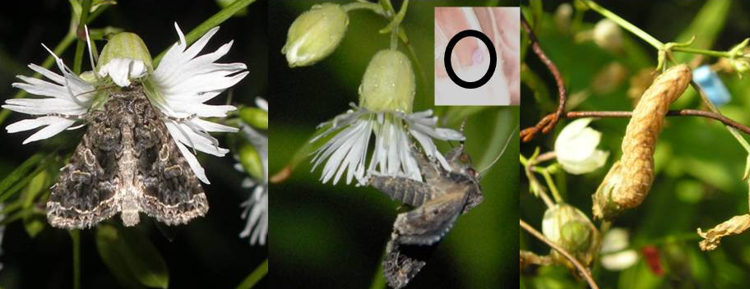
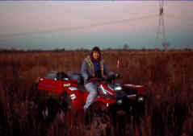
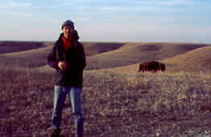
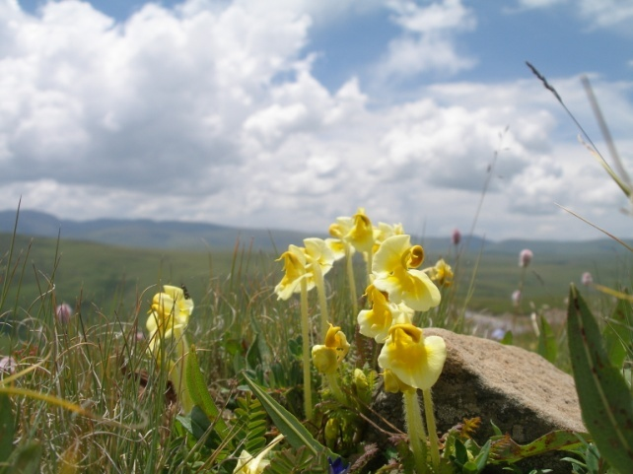
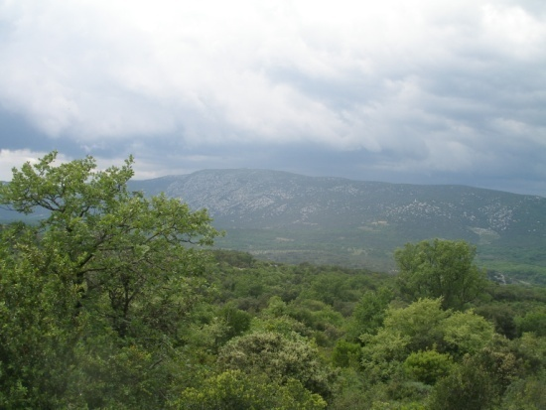
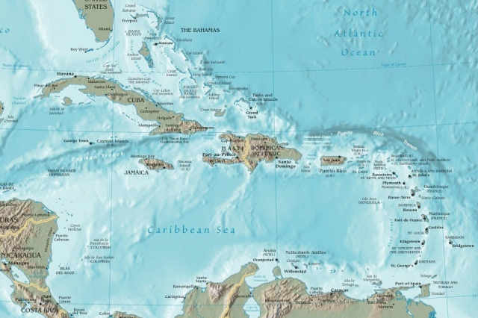







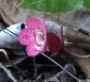

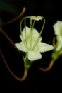

Maad, Armbruster
Evolutionary process within an Ecological context
Galloway
Flower size variation along an
altitudinal gradient (Alpine, Norway)
Dudash, Biere, Castillo, Dotterl, Holland, Kula , Reynolds, Zhou
Silene stellata-Hadena ectypa interaction
(mutualism evolution, food web approaches,
sexual conflict)
Erickson
Epistasis for fitness
(Prairie, Illinois)
Quantifying QTL effects
(Prairie, Kansas)
Huang, Ree, Hereford, Eaton
Rutter, Lenormand, Imbert,
Agren, Weigel, Wright
Marten-Rodriguez
Quantifying Mutations
(Garrangue, France)
Reproductive isolation and
community sorting in Tibetan Pedicularis
Pollination and breeding system evolution
in Gesnerieae (Caribbean)
Notes:
Because much of my genetic work involves quantifying the genetics of fitness, many of our studies are conducted in the wild with attendant and relevant natural selection pressures that provide a realistic estimate of genetic effects on fitness. But….I am interested in understanding evolutionary process and I think it is important to consider the ecological context in which it occurs.
The ecology of the organism defines the selective pressures that is exerted upon that organism.
I am also interested in ecological questions at both the population and community level.
For example we consider the Silene-Hadena system as a model for the study of mutualsim evolution. In this system….and there are other moth species which are strictly mutualists in this system. Thus the reliance of Silene on Hadena for pollination is facultative, allowing us to determine the conditions which make this interaction a parasitism or a mutualism. We are using food web approaches with Nat Holland to understand the maintenance of this system.
Our work with Pedicularis in Tibet addresses basic questions of community ecology and community assembly

Slide 4
Outline
1) BOTTOM UP: Input of genetic variation
  Mutation parameters
2) TOP DOWN: Natural selection & species selection
Natural selection and the assembly of complex traits and consequences for phylogenetic patterns
3) SIDEWAYS: Plant – Animal interactions
Context dependent interaction outcomes
4) CONSERVATION GENETICS
Genetic Rescue
Notes:
4
The outline of todays talk is that I will discus the role of mutations in generating standing population genetic variation
And then I will focus on our work to document the role of NS in the assembly of complex traits and consequences for macroevolutionary processes.
If I have time, perhaps during the ? Period, I can talk a little about how our work on epistasis now has relevance for conservation genetic issues including species definitions.

Slide 5
The values of mutation parameters for fitness
determine many evolutionary processes
Parameters: Rate, Effect & Size
Evolution of Adaptation (Fisher, Kimura, Orr)
Beneficial mutation rate, size of effect (s)
Evolution of Sex (Muller’s Ratchet)
Number of Asexual individuals without mutations
PROPORTIONAL to: 1/U (deleterious mutation rate); s
Inbreeding Depression & Mating System Evolution
PROPORTIONAL to: U; 1/s
Notes:
The great irony is that all the biological diversity and adaptations that first drew all of us into biology is the outcome of errors in replication. Thus mutations not surprisingly figure prominently into a number of important evolutionary models and an accurate estimate of mutation parameters will determine the outcome of these models.
For example, rates of beneficial mutations figure prominently into theories of the evolution of adaptations while the deleterious mutation rate figures prominently into models of the evolution of sex and mating systems. Also, the size of the effect of these mutations on fitness, or the selection coefficients, are also important.

Slide 6
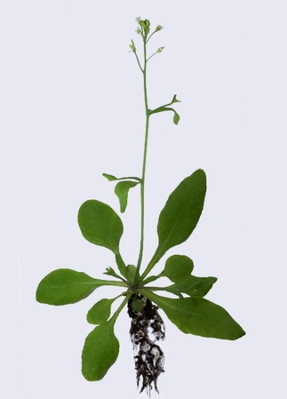
Quantifying mutation parameters using
Arabidopsis thaliana mutation accumulation lines
Matthew Rutter, Jon Agren, Jeff Conner, Eric Imbert, Thomas Lenormand, Angie Roles, Detlef Weigel, Stephen Wright & Charles Fenster
Funding by NSF and Max Planck Society
Notes:
We use the MA line approach to quantify mutations in the Model organism, Arabidopsis thaliana.
As you will see, the fact that Arabidopsis does not move and is relatively large for model orgnisms, allows us to conduct our studies in the wild.
It is a selfing annual, which facilitates the generation of the MA lines and which makes it easier to measure fitness, simply as the total number of fruit produced.

Slide 7
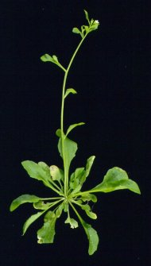

Mutation accumulation lines (MA lines) (Produced by Ruth Shaw)
Nearly homozygous progenitor
Columbia
Single seed
descent in
greenhouse
MA lines
Traits (Fitness):
100 MA lines
25thgeneration
Sequence: 5 MA lines
1
. . .
100
Sublines to control for maternal effects
Test in natural environments:
Any genetic difference between lines are due to mutation
Notes:
Next Gen Seq
We have used the standard Mutation Accumulation line approach to quantify mutation rates and effects. We start out with a homozygous founder, cultivate lines through single seed descent which allows drift to fix very deleterious mutations for multiple generations with the notion that independent mutations are appearing in the lines and over time any genetic differences between lines is due to new mutations.
Variance among the lines gives one an estimate of mutation rate, while the performance of the lines relative to each other and to the founder can give one an estimate of the effects of spontaneous mutations on fitness.
Where we are pushing the envelope is testing in the natural environment where we think more mutations effecting fitness would be discovered because there would be more opportunity for natural selection to see a phenotype affected by a mutation in the wild vs in a lab or greenhouse env where many challenges to the organism are removed.
NOTE THE line are propagated in the GH though we tested them in the field. The lines were supplied to us by Ruth Shaw, and that 5 of these lines were completely sequenced later on, which I will discuss.

Slide 8
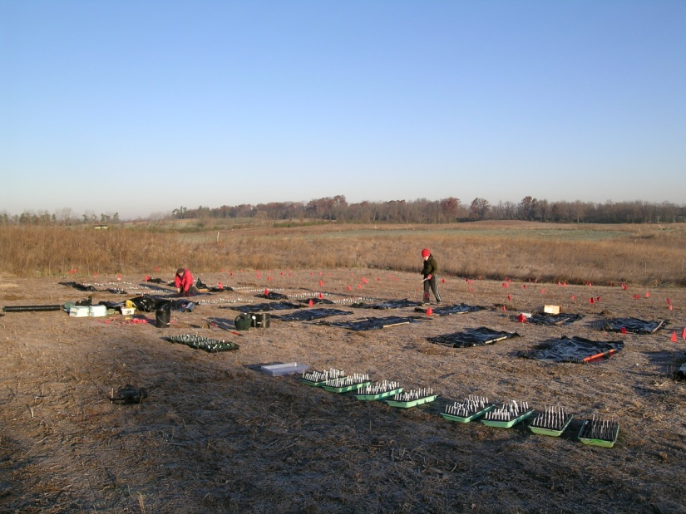
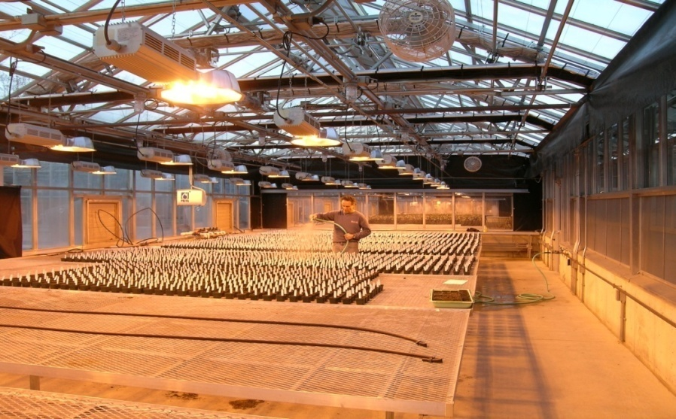
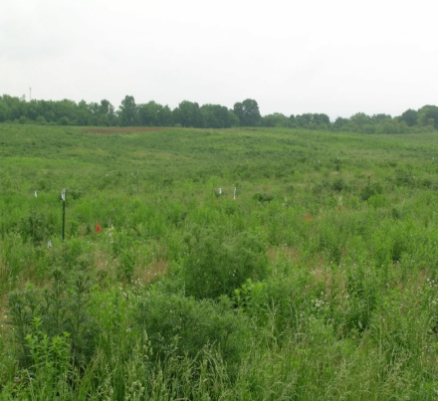
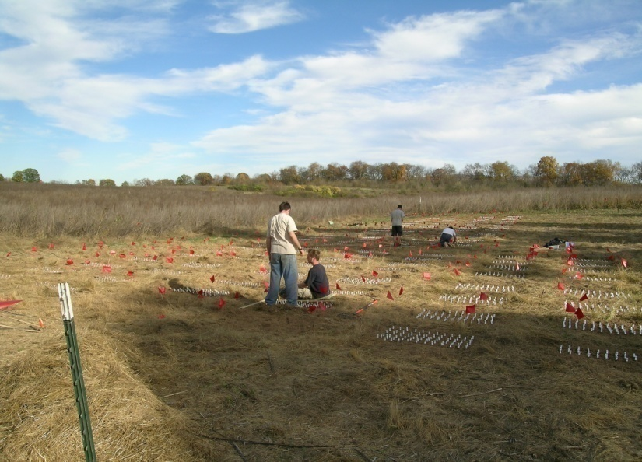
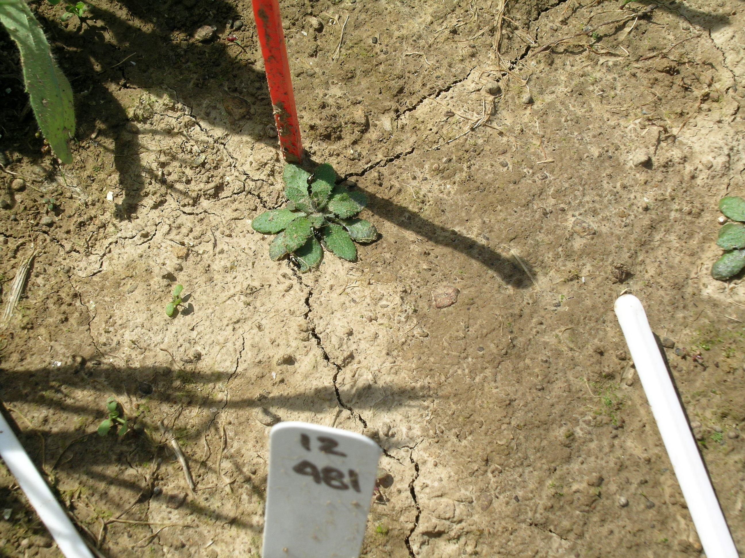
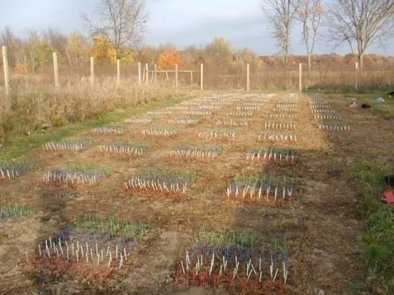
Blandy Farm (UVA) Blue
Ridge of Virginia
Rutter
Total plants:
48,000
100 lines
X
70/line
X
7 Environments
Total fruits:
> 600,000
Kellog Biological Station (MSU), southern MI
Roles and Conner
Fall field planting (2x)
Spring field planting (2x)
Fall seed field planting VA and MI
Greenhouse
Notes:
Using high replication to account for env variation, we planted the MA lines in 6 natural env, 4 fall plantings, corresponding to 2 life cycles commonly found with A thaliana, the w-a life cycle where seeds… and the spring ephemeral …..
Unlike the GH, these field plantings were exposed to competition from the surrounding vegetation and herbivory and likely other stresses.
We did all of these experiments because one of our fundamental questions was how mutations behave in different environments, whether uniformly bad, good or perhaps dependent on the env context.
.

Slide 9
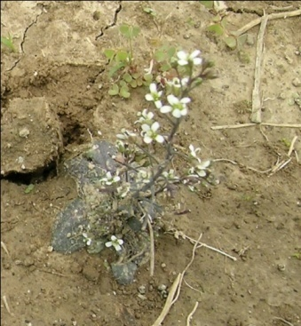
Results (Spring Planting):
1. MA lines diverged in fitness (P < 0.029)
2. Founder performance near average MA performance
Founder
14
12
10
8
# of MA lines
6
4
2
0
9
10
11
12
13
14
15
16
17
18
19
20
21
22
23
24
25
26
Fruit number (mortality adjusted)
Rutter et al. 2010
Notes:
Here are our results from one planting but which are typical of all of our experiments.
Read 1 and 2.
You can see this by looking at the distribution of performance of the MA lines, read the x and y axis and show founder, indicating that a little more than ½ of the lines did worst than the founder and a little bit less than half did better.
These results indicate that the cumulative effects of the mutations can result in an unexpectedly high beneficial mutation rate.
Here’s the big one fitness as measured as a combination of survival and fruit number. Yep it is in the middle.. Talk about poor progenitor NOTE SURVIVORSHIP

Slide 10
Reaction Norm of Fitness Rank Across Seasons
100
90
80
70
40 MA lines
switch fitness
relative to parent
60
Founder
Fitness
Rank fitness of MA lines
50
40
30
20
10
0
Spring
Fall
Season
Notes:
Since we grew the same lines in multiple environments we could make a robust estimate of GXE for mutations
GXE, explain x and y axis, note founder fitness in the middle but many MA lines change

Slide 11
Mixed Model Analytical Approach to Quantify
G x E on Fitness
100 MA Lines & Founder Planted in 2 Spring & 2 Fall Experiments as Seedlings
Large Effect of Environmental Variables (Block, Season, Experiment, Year)
MA Line x Experiment (4) P = 0.0006
MA Line x Year (2) P = 0.0015
MA Line x Season (2) P = 0.022
MA Line : (100) P = 0.053

Slide 12
Fitness Mutation Parameters in the FIELD:
(Rutter et al. 2010, 2012 & unpublished)
Whole genome mutation rate for fitness = 0.12 (haploid)
Mutation effects relative to the environment are small: h²m for fitness ~ 1 x 10⁻⁴
High frequency of beneficial mutations
G X E: variance G x E (MA line effects in 3/4 experiments)
MA line x Season
MA line x Year
MA line x Experiment
Mutations Contribute Substantially to Population Genetic Variation of Fitness
Notes:
Read through, stress, high whole mutation rate because assessing fitness in field.
Env variance4order of magnitude greater than cumulative effect of mutations, some might have large + or – effect on fitness
GxE
See many beneficial two reasons, small effect, consistent with Fisher’s theory and I will talk about this and the second reason shortly
did not test in the home environment of the Columbia accession which is in N. Germany

Slide 13
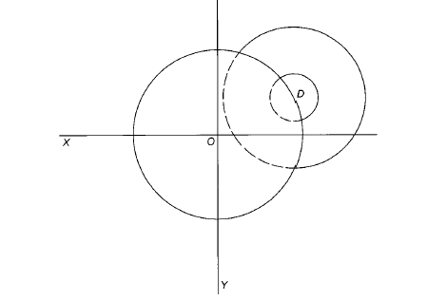
Adaptive landscapes & mutation parameters
“The vast majority of mutations are deleterious… [a] well-established principle of evolutionary genetics”
Keightley and Lynch, 2003
Fisher, 1930
Beginning of a conceptual framework for the prediction of mutation effects
NSF Arabidopsis 2010, Rutter and Fenster (with T. Lenormand, E. Imbert & J. Agren)
Notes:
13
In our ongoing work we are using Fisher’s geometric model of a mutational walk to the optimum to try to understand our results of high beneficial mutations as well as provide a predictive framework for Env x mutation effects.
One property of this model is that the further a genotype is away from the optimum, the greater the phentypic space for mutations to be beneficial. The Exp distrib of QTL effects, with many small and a few large effects found in some data sets is consistent with this idea, with initial steps toward the adaptive optimum including mutations of large effect, and many small steps or small effect mutations get you to the optimum.
Modelled as an adaptive walk by ORR, which depends on beneficial space decreasing
Briefly explain model.
Invasive Biology
Columbia mutation lines originally from N. Germany tested in Virginia and Michigan. Thus we have collected new genotypes, and are cultivating new MA lines to determine the effects of mutations when tested in their home and away environments. With the expectation that mutations tested in their home env will more likely be deleterious, while tested in novel environments they will be more beneficial mutations.

Slide 14
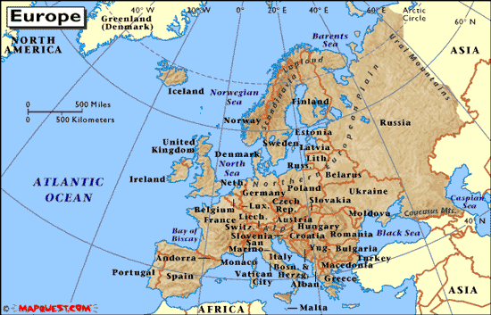
Ongoing: New MA lines developed from French and Swedish genotypes
NSF Arabidopsis 2010 (Rutter and Fenster with Lenormand, Imbert & Agren)
Notes:
14
We acknowledge using Columbia…in virgina, but???
Using A2010 funding we have initiated new MA lines from central Swedem and S France, the range of A. in europe with the notion of quantifying mutation rate and effect on fitness in home and away environments.
==
So I said that our best hypothesis of why we are seeing so many beneficial mutations is that the founding genotype of these MA lines may be a very poor performer. It happens to be the most commonly used lab line of Arabidopsis, it is the line that has been sequenced, for example. Its origin was in Germany, not Virginia, and it has a long history in the greenhouse and in growth chambers before ever serving as the founder of this experiment. It’s possible that the various selection regimes the genotype has been under in the last hundred years have transformed it to a genotype that does not perform well in natural conditions, or all that well in lab conditions. Or that the methods of artificial lab selection led to a plant that just doesn’t make that much fruit.
Our intent is to test this question by founding new mutation accumulation lines, from native populations in Europe, part of the native range of Arabidopsis. Then we can plant these new MA lines back into their original environment, test them in an environment where perturbations of the genotype may be more likely to make changes from a selective optimum.

Slide 15
We need a mechanistic understanding of the relationship between mutations and fitness
Mayr, 1959, 1963
Wright and Andolfatto 2008
Nei 2013
Notes:
Nei, Confessions of a strayed population geneticist

Slide 16
Sequenced 5 MA lines vs. Founder
(Ossowski et al. 2010)
Dark blue = nonsynonymous or indel in coding region
Total =114 mutations detected
Notes:
Group led by Detlef Wiegel, who we ARE NOW collaborating with.
Mention nonsynonymous indel in coding regions
====
Fig. 1. Distribution of spontaneous mutations across chromosomes. Labels indicate the type of mutation and colors their functional context or predicted effect. Short insertions and deletions are shown by the letters representing the affected bases preceded by a plus or aminus sign, respectively. Long deletions are depicted by aminus sign and the number of deleted base pairs in parentheses. An asterisk next to a C or a G means that the cytosine of the mutant base pair is known to be methylated (20). The definitions for colors are as follows: red, intergenic region; yellow, intron; dark blue, nonsynonymous substitution, shift of reading frame for short indels, or gene deletion for large deletions; green, synonymous substitution; purple, UTR; and light blue, transposable element.
UTR equals untranslated just upstream and downstream region, transcribed but not translated, can be associated with efficiency of translation and stability of the mRNA

Slide 17
Synthesizing Sequence and Phenotype Results
(Rutter et al., 2012)
Sequence experiment:
Mutation rate = 0.7/haploid
Nonsynonymous mutations and indels in coding region = 0.1/haploid
Field experiment:
0.12/haploid affecting fitness
Notes:
Go through quickly,
Note corresondence between NS and indels and our estimate.

Slide 18
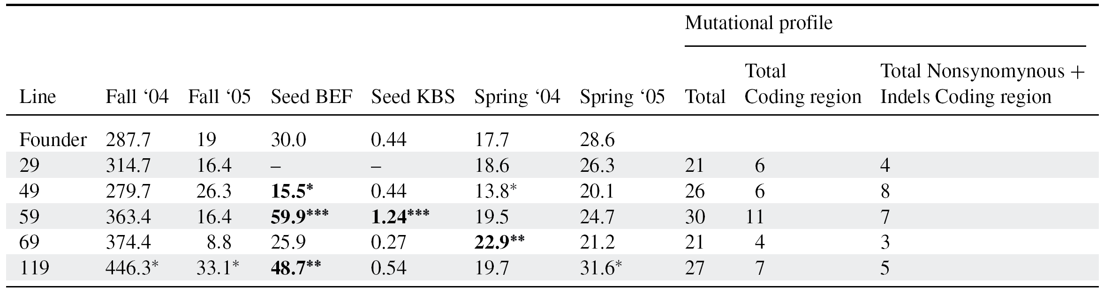
Mean fruit production of 5 MA lines and the founder premutation line and their mutational profile
Rutter et al., 2012
Fitnesses were estimated using an aster model including survival (binomial) and fruit number (Poisson). P-values (* P < 0.05, ** P < 0.01, *** P < 0.001) represent MA-founder comparisons. P-values were calculated by likelihood ratio tests, and validated using a parametric bootstrap. Means in bold represent a significant difference following within experiment sequential Bonferroni correction (P < 0.05). BEF = Blandy Experimental Farm; KBS = Kellogg Biological Station. Significant GxE (aster model, P<0.05)
FYI: MA line 49: deletion includes DNA binding transcription factor
MA line 119: large deletion in a gypsy class retrotransposon
Notes:
Say it more cleaner
Lots of variation in fitness across environments seen by fitness of founder across env. ranged from nearly 300 fruit per individual to less than ½ a fruit per replicate.
Note as before some lines did better some worse than founder.
Despite the small sample size of only 5 lines we can say some interesting things about the mutational profile of the different lines and their performance.
Line 29 few mutations. Line 49, poor had a 3 locus deletion including a transcription factor, and line 119 had a deletion of a transposon, and high fitness, perhaps congruent with the reduction of genome size across the evolution of the genus Arabidopsis.
Three points: performance, number of mutations, even with this small sample size we see: type of mutations

Slide 19
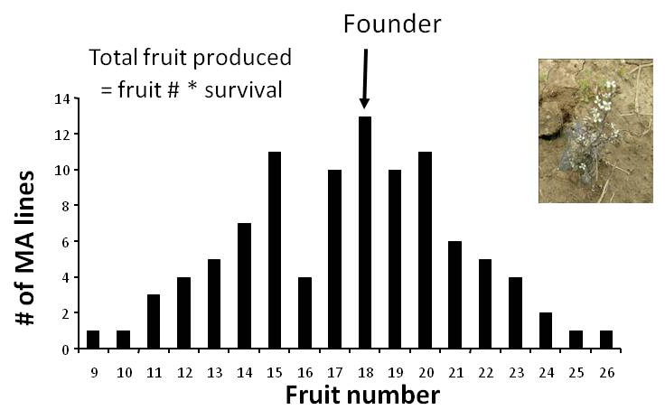
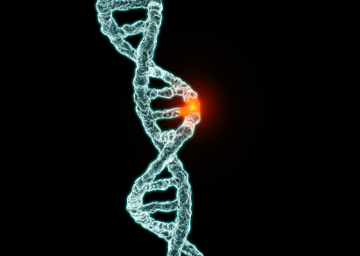
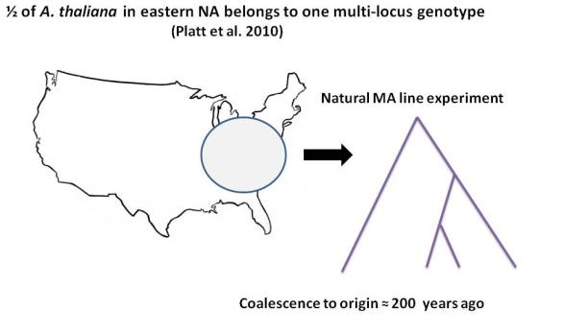
Current NSF Funding to Fully Sequence
Fenster, Rutter, Weigel, Wright:
100 Columbia MA lines
(tested in 7 environments)
320 Swedish and French MA lines
(tested in both FR & SW)
>50 genotypes representing one multilocus genotype
(tested for 1-200 generations in N. America)
Sequence
Fitness
Notes:
We have tested the performance of 100 MA lines in 6 env and fully sequencing these lines will allow us to associate types of mutations, maybe even specific mutations with performance

Slide 20
Mutation rates and spectrum and interface with natural selection
Goal:
Precise estimates of mutation rate and spectrum (including genetic variation for mutation rate)
About 6500 natural mutations that can be related to fitness
Compare genetic variation due to mutations to standing genetic variation & to genetic differences between species
Notes:
Read through quickly,
How does NS act as a filter for beneficial mutations and against deleterious mutations
Our work allows us to Mvs G allows us to examine many important questions related to genetic constraints to evolution
We hope our Mutation resources will be as valuable to the community as Phil Ives fly collections were to the Drosophila communit
G and A are purines, so transition mutation favor G to A, much higher AT content predicted than actually seen.
Rationale: Comparison of the mutational spectrum in A. thaliana with closely related species has revealed a mutational bias that is not mirrored in the outcome from natural selection. For example, while G:C→A:T transitions are overrepresented in the MA lines (Ossowski et al. 2010), the same bias was much less pronounced when considering rare derived variants, which are presumably mostly young and have experienced on average little selection. The pattern is seen in 80 fully sequenced accessions (Cao et al. 2011) and disappears with variants that have arisen to high frequency since A. thaliana and its sister species A. lyrata split.
There has been a decrease in size of the A. thaliana genome relative to A. lyrata, consistent with both a deletion bias in mutations and with selection for a reduced genome. Having a much greater sample size of sequenced MA lines representing multiple genetic backgrounds will provide greater confidence in the nature of mutational bias and greater inference on how genetic variation is altered by evolution by comparison with the spectra of genetic differences among naturally diverged populations (accessions, NA lines, and related species). Comparison of the mutational spectrum between the MA and NA lines (exposed to natural mutagens) allows us to assess the validity of quantifying the mutational spectrum in lab generated lines.
Using regression, nested ANOVA and appropriate multivariate analyses we will assess how the mutation spectrum for each line (number of mutations, number of nonsynonymous mutations, number of indels, number of mutations in different classes of genes, etc. contribute to performance in each environment and across environments to estimate mutation effect size. Our analyses are similar to analyses conducted comparing the fitness effects of random mutations in bacteriophages (Domingo-Calap et al. 2009). We can also test (via ANOVA) if MA lines have larger fitness deviations from the founder if they contain mutations in regions conserved within A. thaliana accessions or across closely related species.
In more detail, we will fit a series of models to the fitness data, from the simple y_{i} = cx_{i} (where y_{i} is the fitness of a plant of MA line I, x_{i} is the total number of mutations in line i and c is a constant) to more complex models such as y_{i} = c₁N_{i} + c₂S_{i} (where N_{i} and S_{i} are the respective number of nonsynonymous and synonymous mutations in line i). Even more complex models would account for the numbers of insertions and deletions, whether they occurred in coding regions, interactions among mutations, etc. We would choose between models using model selection and multimodel inference procedures (Burnham et al. 2002; Burnham et al. 2011) and would evaluate the significance of each predictor in the appropriate models.
In both prokaryotes and eukaryotes, most of the mutations caused by ultraviolet (UV) light are G: C→A:T transitions at sites where the C is adjacent to another C or to a T (dipyrimidine sites) Among the 33 observed transition mutations at nonmethylated G:C sites, 31 were in dipyrimidine contexts, which is more than expected by chance at the P = 0.02 level (Fisher’s exact test). Thus, we conclude that the increased rate of transitions at G:C sites, relative to A:T sites, can be largely explained by the combined effect of UV-induced mutagenesis and deamination of methylated cytosines. This implies that the mutation rate in nature could be higher than that reported here, becauseUVradiation during the MA experiment was probably lower than in natural conditions.

Slide 21
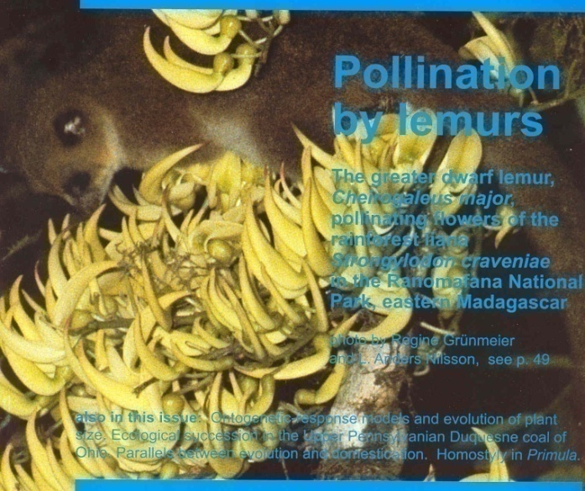
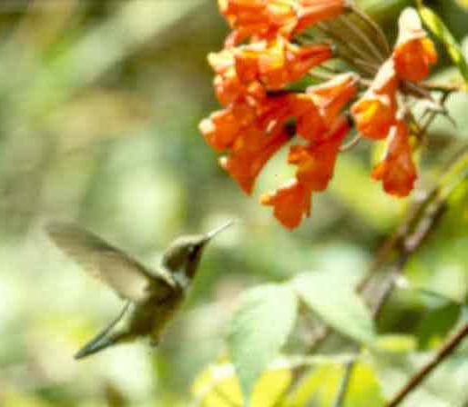
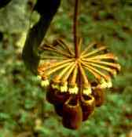
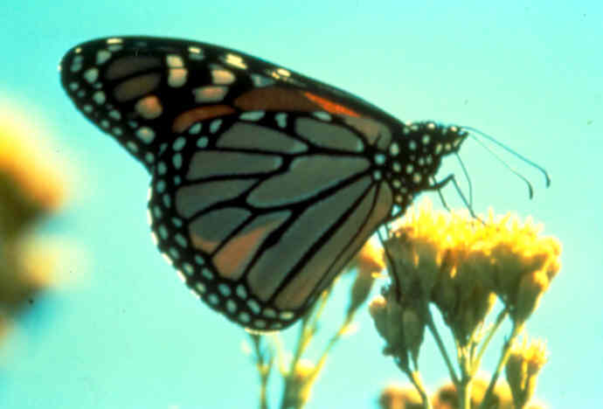
Natural Selection (top down)
“From the observations of various botanists and my own I am sure that many other plants offer analogous adaptations of high perfection…” (Darwin, 1877)
Fenster et al. 2004
Notes:
21
Know what the species are! Focus on trait combinations
LEMUR POLLINATION IN THE MALAGASY RAIN-FOREST LIANA STRONGYLODON CRAVENIAE (LEGUMINOSAE)
Margavia
Bomeria

Slide 22
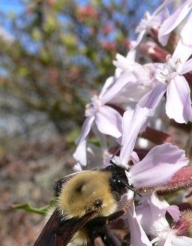
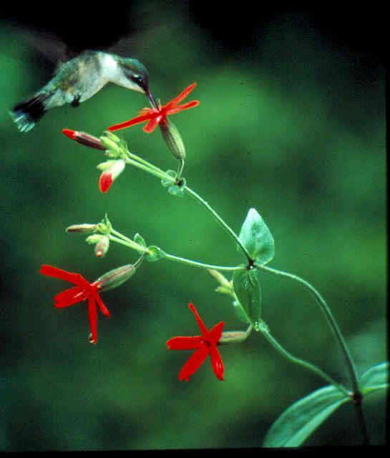
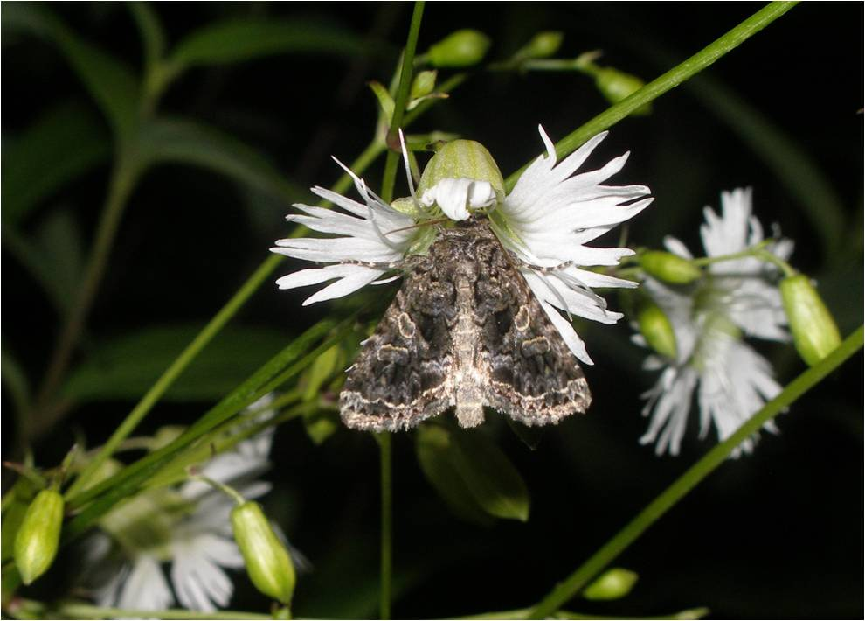
Documenting Patterns of Natural Selection Responsible for Silene Floral Evolution
S. caroliniana S. virginica S. stellata
M. Dudash, R. Reynolds, A. Kula, S. Konkel, J. Zhou & many NSF REU’s
Funding: NSF, National Geographic Society, UVA Pratt Fund
Notes:
22
Within species selection. Selection studies on all 3, Reporting only on one today, discuss differences between species

Slide 23
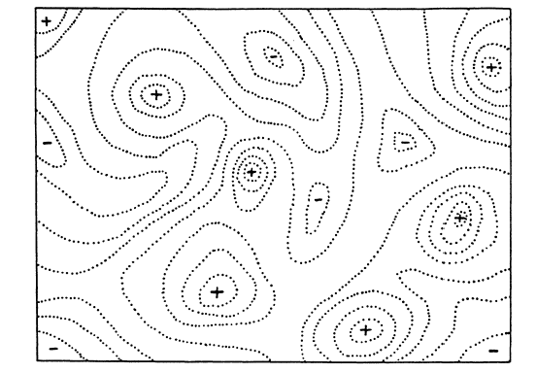
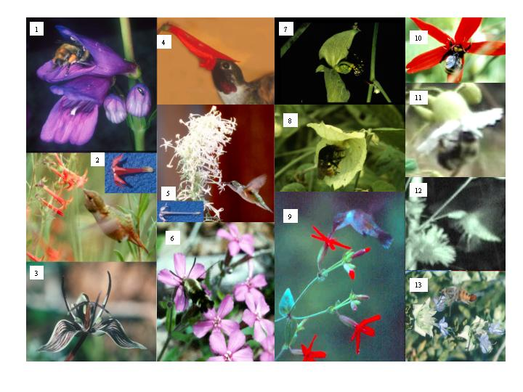
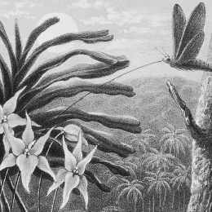
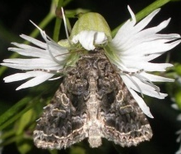
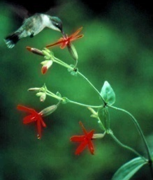
Does natural selection act on trait combinations?
The Adaptive Landscape:
Simpson 1944
-
22 23 24 25 26 27 28 29 30 31 32 33
1 2 3 4 5 6 7 8 9 10 11 12 13 14 15 16 17 18 19 20 21
Trait Combination:
Adaptations reflect adaptive trait combinations

Slide 24
Does natural selection act on trait combinations?
-
S. virginica
Phenotypic Selection Analyses: YES
(Reynolds et al., Evolution 2010)
Notes:
You can imagine that the peaks represent movement up a selective gradient, where there is a bias in transition of the surrounging area of a peak towards the peak. However, different adaptive peaks may have different speciation rates, or species selection. So the population of these peaks with species may instead reflect species selection, with peaks having higher diversification rates than surrounding areas.
Does the population of species on these peaks of trait combinations represent selection favoring these traits or higher diversification associated with these peaks
Also experimental evidence

Slide 25
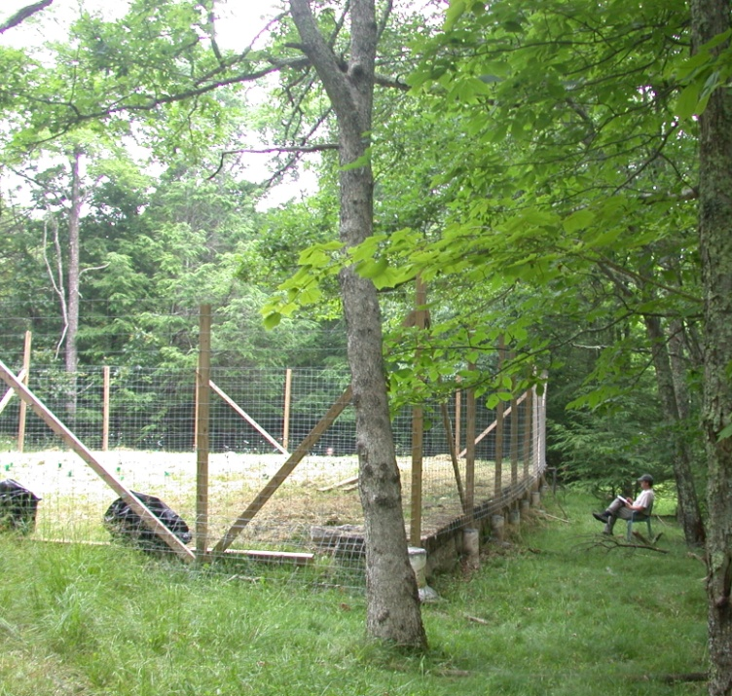
Experimental Approach:
Array Design
3
4
2
1
*Trial = approx. 25 plant visits in a block or flowers were empty of nectar
*30 minutes - 90 minutes (four observers)
*Total of 28 Trials run
2072 Plant visits
Notes:
Each of the points represents one of the 48 combinations

Slide 26
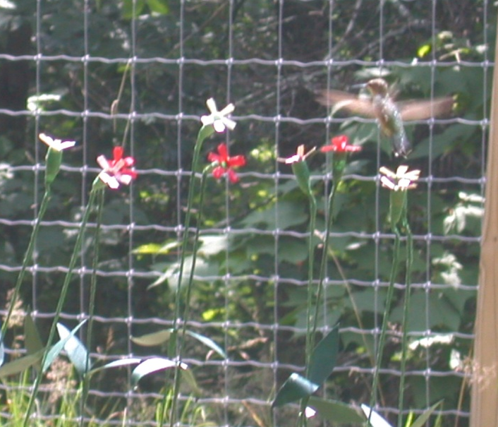
Response Variables:
# of visits per plant
= proxy of fitness
S. virginica: Red, Tall, Diffuse, Horizontal, Narrow
S. caroliniana: Pink, Short, Clump, Vertical, Narrow
S. stellata: White, Tall, Clump, Horizontal, Wide
+ 45 other combinations
Notes:
Note flowers and hummbird choosing

Slide 27
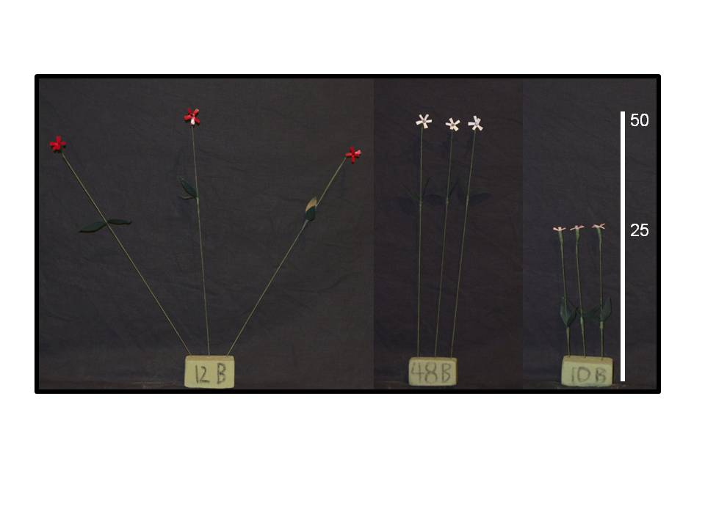

Slide 28
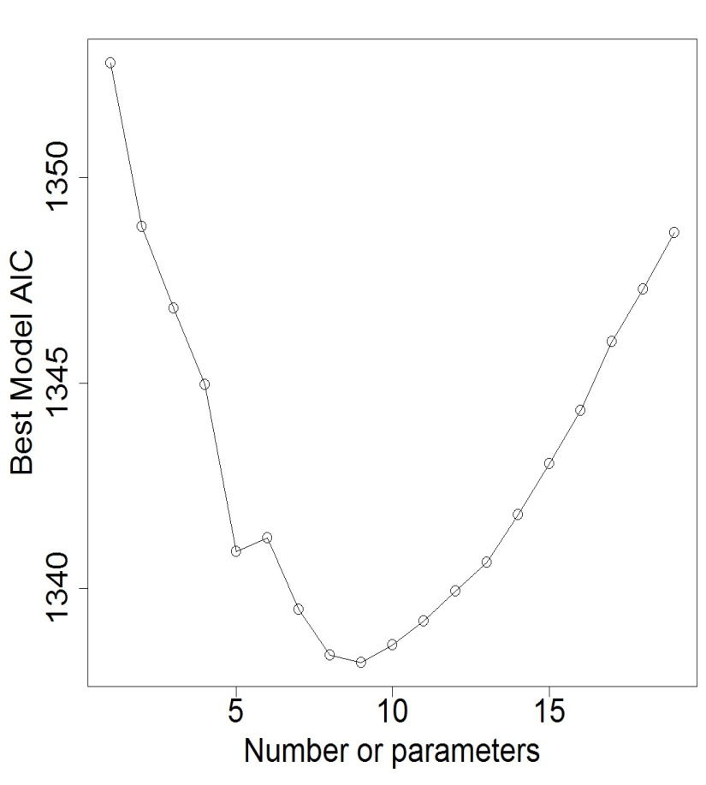
Model Selection Approach:
Best-subsets regression analysis of main and interactive effects
.
Response variable:
Plant visits by hummingbirds AIC score comparisons
 | Number of Variables in Best Model
 | 1 | 2 | 3 | 4 | 5 | 6 | 7 | 8 | 9 | 10
Intercept | X | X | X | X | X | X | X | X | X | X
FLHT |  | X | X | X | X | X | X | X | X | X
FC2 |  |  |  |  |  | X | X
PRES |  |  | X | X | X |  |  | X | X | X
IA |  |  |  |  |  |  |  |  |  | X
TW.FLHT |  |  |  |  |  |  | X
FLHT.FC2 |  |  |  |  |  |  |  |  | X
FLHT.PRES |  |  |  |  |  |  |  | X | X | X
FLHT.IA |  |  |  |  |  |  |  |  |  | X
FC2.PRES |  |  |  |  |  | X | X
FC1.IA |  |  |  |  | X | X | X | X | X
FC2.IA |  |  |  |  |  |  |  | X | X
FLHT.FC1.IA |  |  |  |  |  |  |  |  |  | X
FLHT.FC2.IA |  |  |  |  |  |  |  |  |  | X
FLHT.FC2.PRES.IA |  |  |  |  |  |  |  | X | X | X
PRES.IA.FLHT.TW.FC1 |  |  |  | X | X | X | X | X | X | X
Fenster, Reynolds, Markowski, & Dudash in prep
Notes:
We used best-subsets regression to determine two things, (1) what subset size of predictors was most important for explaining variation in hummingbird visitation and (2) what order of entry into the model were the main effects vs interaction effects
In this section, we learn about the best subsets regression procedure (or the all possible subsets regression procedure). While we will soon learn the finer details, the general idea behind best subsets regression is that we select the subset of predictors that do the best at meeting some well-defined objective criterion, such as having the largest R² value or the smallest MSE.
the general case, the AIC is where k is the number of parameters in the statistical model, and L is the maximized value of the likelihood function for the estimated model. Given a set of candidate models for the data, the preferred model is the one with the minimum AIC value. Hence AIC not only rewards goodness of fit, but also includes a penalty that is an increasing function of the number of estimated parameters. This penalty discourages overfitting (increasing the number of free parameters in the model improves the goodness of the fit, regardless of the number of free parameters in the data-generating process).
AIC is founded in information theory. Suppose that the data is generated by some unknown process f. We consider two candidate models to represent f: g₁ and g₂. If we knew f, then we could find the information lost from using g₁ to represent f by calculating the Kullback–Leibler divergence, D_{KL}(f ‖ g₁); similarly, the information lost from using g₂ to represent f would be found by calculating D_{KL}(f ‖ g₂). We would then choose the candidate model that minimized the information loss.
We cannot choose with certainty, because we do not know f. Akaike (1974) showed, however, that we can estimate, via AIC, how much more (or less) information is lost by g₁ than by g₂. It is remarkable that such a simple formula for AIC results. The estimate, though, is only valid asymptotically; if the number of data points is small, then some correction is often necessary (see AICc, below).

Slide 29
Does selection act on trait combinations?
Yes
Contemporary selection on S. virginica is correlational
(Reynolds et al. Evolution 2010)
And Yes
Experimental manipulation of floral traits demonstrate hummingbirds visit based on floral trait combinations
Notes:
29
Pollinator mediated selection
We have provided evidence that wonderful corrleation of traits, known as pollination syndromes, reflect selection acting to build these combinations

Slide 30


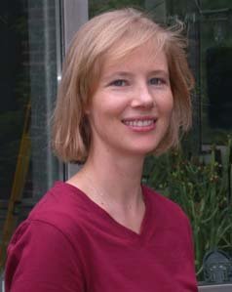
Can we use the phylogeny of the angiosperms to document multi-trait selection?
2
NESCent Working Group:
“Floral Assembly: Quantifying the composition of a complex adaptation”
Charlie Fenster (PI), Pam Diggle (coPI) Scott Armbruster (coPI) , Lawrence Harder, Stephen Smith, Amy Litt, Lena Heilman, Chris Hardy, Peter Stevens, Larry Hufford, Susanna Magallon
AND….
Brian O’Meara Stacey Dewitt Smith
Notes:
30

Slide 31
Stebbins 1951 in a nutshell:
“A flower is … a harmonious unit.”
For 8 floral traits examined two states.
Expect 2⁸ different combinations found in angiosperms.
But observed only 86/256 possible combinations & 200 of the 400 families represented 12 different combinations!
Uneven distribution.
“The characteristic [combinations] of many genera and
families [represent] peaks.”
Notes:
Suggests that certain traits are only adaptations when expressed with certain specific trait combinations, selection favors the simultaneous occurrence of certain traits. Selection increases the association or correltation between these traits talk about traits, inferior superiour, fusion of petals separate petals, etc.

Slide 32
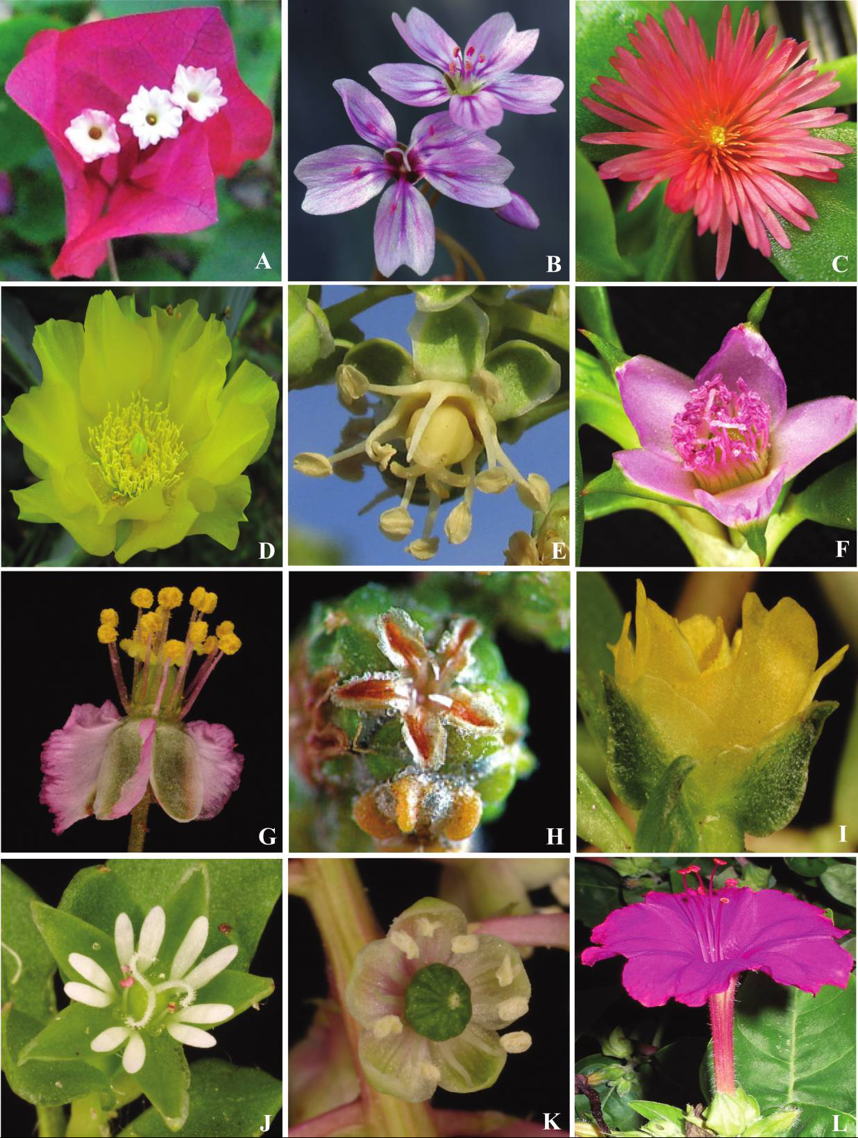
The Angiosperm Flower is Highly Labile:
Convergence through multiple developmental origins
Attractive Features in the Core Caryophyllales
Sepals, Bracts
Sepals
Stamens
Leaves
Stamens
Sepals
Sepals
Sepals
Sepals
Stamens
Sepals
Sepals, bracts
Brockington et al., 2009
Notes:
32
Incredibly labile, its evolution provides lots of df for comparative approaches

Slide 33
Is natural selection responsible for the
combination of floral traits in angiosperms?
Analysis:
For 8 floral traits examined two states.
Expect 2⁸ different combinations found in angiosperms.
Results:
Uneven and non-random distribution
86/256 possible combinations observed
200 of the 400 families represented 12 different combinations
Conclusion:
“The characteristic [combinations] of many genera and
families [represent] peaks.”
Notes:
Suggests that certain traits are only adaptations when expressed with certain specific trait combinations, selection favors the simultaneous occurrence of certain traits. Selection increases the association or correltation between these traits talk about traits, inferior superiour, fusion of petals separate petals, etc.

Slide 34
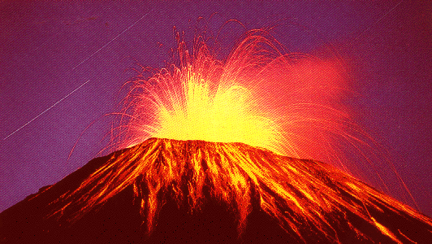
-
Binary State Dependent Speciation & Extinction (Markov Models)
Maddison et al. 2007
q01
r0
0
1
r1
q10
Ancestral (root) Derived
Natural Selection: Is there a bias in trait transitions?
Species Selection: Do some combinations lead to greater net diversification than others?
Brian O’Meara and NESCent Working Group
Notes:
Brian built upon this framework with a truly Novel approach

Slide 35
Extending BiSSE to Trait Combinations:
Six Major Angiosperm Traits Scored
(2⁶ combinations = 64 combos)
Ancestral Trait State | Derived Trait State | Combo Score for Derived Trait State
Corolla present | Corolla absent | 1*****
Petals separate | Petals fused | *1****
Symmetry radial | Symmetry bilateral | **1***
Stamens many | Stamens few | ***1**
Carpels separate | Carpels fused | ****1*
Ovary superior | Ovary inferior | *****1
e.g.: Corolla present, Symmetry bilateral, Stamens few: 0*11**
Notes:
6/8 traits important for floral evolution, pollinator precision, pollen competion, draw attention to focal group concept
We aimed to estimate rates of gain and loss of each character state and character-state combination as well as the effect of these character transitions on diversification. To do this, we combined the recently developed binary state-dependent speciation and extinction (BiSSE) models (Maddison et al. 2006, FitzJohn et al. 2009) with a novel approach to exploring character state space. Given our six floral characters, we have 2⁶ or 64 character-state combinations, which can be portrayed as string of binary states, e.g. 000111 and 111000. Thus, combination 000001 corresponds to the ancestral state for all characters except for character 6, ovary position (Table 2). These 64 combinations can be viewed as a network with each combination (each vertex)
Within this framework, we explored a set of models to detect differential transition rates and/or diversification rates in focal states. In the Markov models used in these analyses, and generally in phylogenetics, it is assumed that in a given time instant only one state can change (Pagel, 1994; O’Meara, 2012). Thus, we only estimated transition rates between combinations differing by a single character (e.g. 000000 and 000001); all other transition rates were set to zero. In total the full model contains 64 x 6 or 384 possible transitions. After dividing the network into the focal and non-focal states (e.g. Fig. 1), we can consider how transition rates between the two regions might differ. Specifically, we tested five different transition rate models, which are listed in Table 3. For example, in model 4, lineages move into and out of the focal state at different rates (although transitions among all non-focal combinations proceed by a single rate (q_{NN}) as do transitions among focal combinations (q_{FF})). Thus, if the focal state was ****10, all transitions among all combinations lacking that state (e.g. 000000, 000001) would proceed at the rate q_{NN,} all transitions among all combinations having that state (e.g. 000010, 000110) would proceed at the rate q_{FF,} and transitions between these two regions of state space would proceed at rates q_{NF} (e.g. 000010→000000). and q_{NF} (e.g. 000000→000010).
We took a similar approach to testing for differential diversification of focal states. The BiSSE model separately estimates the two components of diversification rate, speciation rate (λ) and extinction rate (μ). We created six diversification models, which are listed in Table 4. These span more complex models with freely estimated speciation and extinction rates (model 6) to simple pure-birth (zero extinction) Yule models (model 1).
We tested all possible pairs of transition and diversification rates models (5 transition x 6 diversification for 30 total) using our dataset of 466 taxa and the single ML chronogram. These models are nested with respect to the most complex model examined (four transition rates, four diversification rates) but not always with each other. Thus, model fit was examined using the Akaike Information Criterion or AIC (Akaike, 1974). In total we examined 21,114 models across the 729 focal states and 30 differential diversification/transition models. We ranked the models using AIC and also computed model-averaged rates for all eight transition and diversification parameters by averaging the value across models weighted by the AIC value of the model. To determine how sensitive our results were to the specific maximum likelihood topology and branch lengths, we repeated the analyses across a set of 100 bootstrapped trees from RAxML (see above).
We don’t say this in the results!

Slide 36
Binary State Dependent Speciation
& Extinction (Markov Models)
Maddison et al. 2007
q01
r0
0
1
r1
q10
Ancestral (root) Derived
Series of bipartitions for 6 traits each with 2 character states:
For any character the state could be: 0, 1, or *
3⁶ bipartitions x 5 rate models x 6 transition models

Slide 37
Transition Rate models for Focal and Non-Focal States
K is the number of free parameters in the model
 | Model | K | q_{NF} | q_{NN} | q_{FF} | q_{FN}
1. | Equal | 1 | q_{NF} = q_{NN} = q_{FF} = q_{FN}
2. | Inflow unique | 2 | q_{NF} | q_{NN} = q_{FF} = q_{FN}
3. | Outflow unique | 2 | q_{NF} = q_{NN} = q_{FF} |  |  | q_{FN}
4. | Inflow and outflow different | 3 | q_{NF} | q_{NN} = q_{FF} |  | q_{FN}
5. | Free | 4 | q_{NF} | q_{NN} | q_{FF} | q_{FN}
Each model contains up to four transition rates (q_{NF}, q_{NN}, q_{FF}, q_{FN}),
where “N” denotes the non-focal state and “F” the focal state. The rate q_{NF} is thus the rate of transitions from the non-focal to the focal state.
Notes:
Table 3. Transition rate models for focal and non-focal states. K is the number of free parameters (transition rates) in the model. Each model contains up to four different transition rates (q_{NF}, q_{NN}, q_{FF}, q_{FN}) where “N” denotes the non-focal state and “F” the focal state. The rate q_{NF} is thus the rate of going from the non-focal to the focal state.

Slide 38
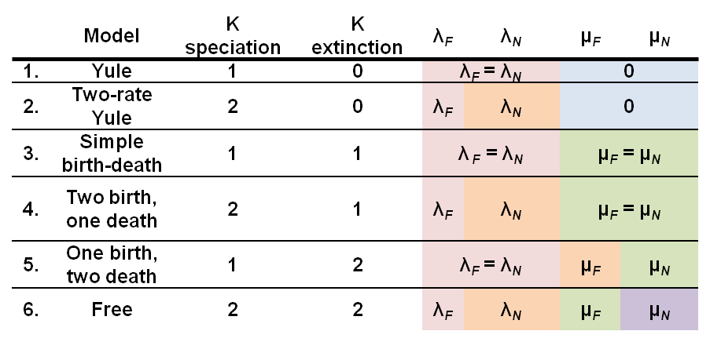
Diversification rate models for focal and non-focal states
K is the number of free parameters (rates) in the model
Each model contains up to four rates (λ_{F}, λ_{N}, μ_{F}, μ_{N}) where λ is the speciation rate (units?), μ is the extinction rate (units?) and “N” and “F” denote the non-focal and focal states, respectively.

Slide 39
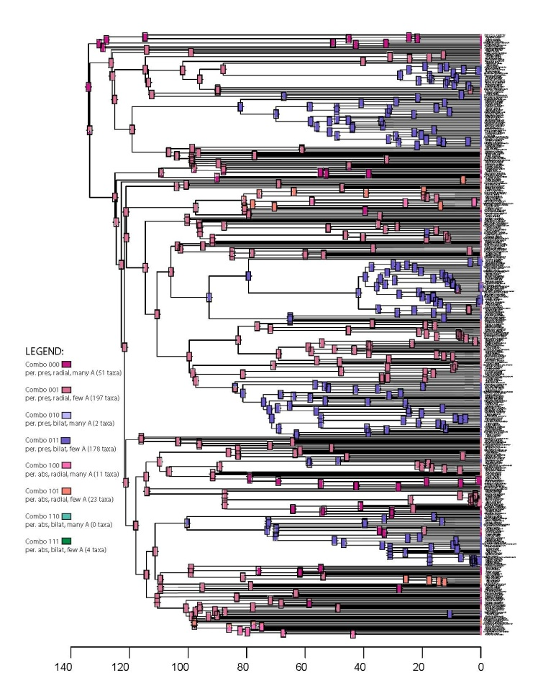
Tree construction methods and
character mapping:
Generated branch lengths by randomly sampling 500 species from
GenBank based on clade size
1.7 megabases of sequence data (7 genes)
Supermatrix constructed with PHLAWD
RAxML
Constrained tree (APG and group knowledge)
40 fossils for calibration points
Determined trait states and trait state combinations
Mapped character states
Notes:
JEN BANK
Mega base = one million base pairs
1,700,000/500 = 3400 bp per species

Slide 40
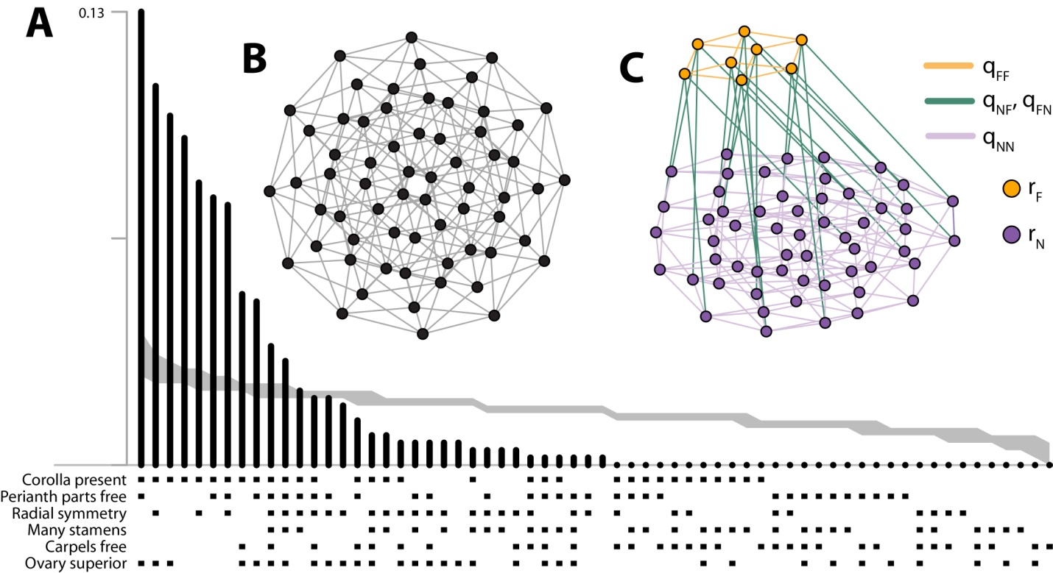
Character evolution & diversification
across the Angiosperms
Trait combination
space
0*11**
High Diversification
Focal state:
Corolla present
Symmetry bilateral
Stamens few
Frequency of Trait Combination
in Sample of Angiosperm
Null Distribution
Observed Trait Combinations & Unordered Null Distribution
O’Meara, Smith et al.
Notes:
Go through trait combinations of two most common carefully.
Trait-combination space and focal areas. Each node represents one of the 64 trait combinations and is connected to six other nodes by change in a single character. Nodes in orange represent a potential focal area, a combination of traits that might experience biased transitions (di­fferences in gain and loss of the focal combination) or differential diversification, nodes in purple are non-focal areas. In the network on the right, all nodes of the focal area have been pulled to the side to show how the network is partitioned into focal and non-focal area

Slide 41
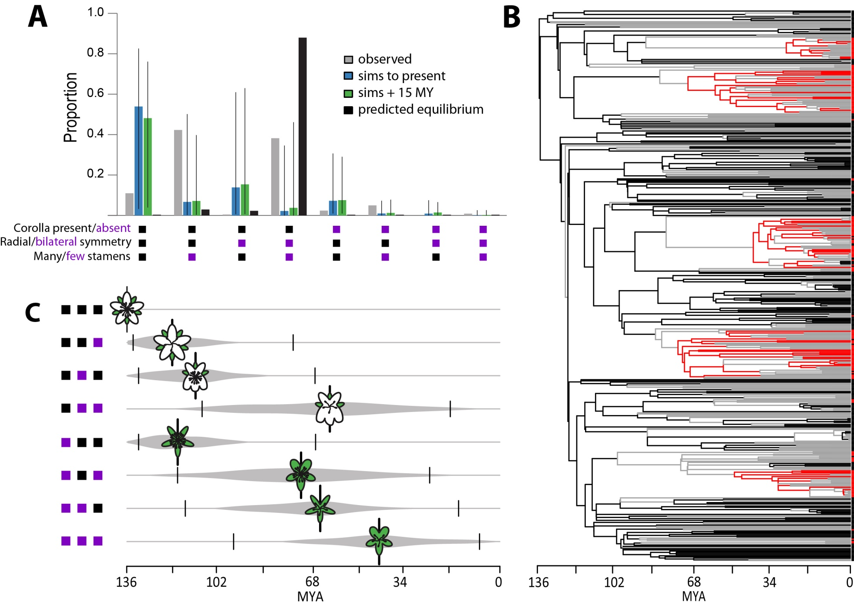
Results of Stochastic Simulations:
ML reconstruction of 3 focal traits:
Expected vs. Observed:
8 Trait Combination Time of Appearance
Notes:
Non-equilibrium dynamics and the evolution of the floral trait combinations. (A) The proportion of taxa with each possible combination of states for the three characters that comprise the focal combination (corolla present, bilateral symmetry, and few stamens) in the observed (empirical) dataset (grey), in stochastic simulations to the present (blue), in the simulations extending 15 MY into the future (green), and at equilibrium (black). The coloring for character states follows Fig. 1. (B) Maximum likelihood reconstructions of the history of the three focal traits for the sample species, incorporating state-dependent diversification showing repeated origins of the focal combination bilateral corolla with few stamens in red. All other combinations are shown in black orand gray lines, with the latter indicating indicate uncertainty in the reconstruction of the subtending node. (C) Mean (± 95% CI) time of appearance of each of the eight trait combinations defined in (A) during the course of simulations. Flower cartoons show states of perianth (white=corolla; green=calyx), symmetry, and stamen number.

Slide 42
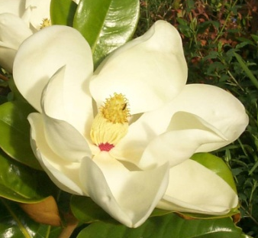
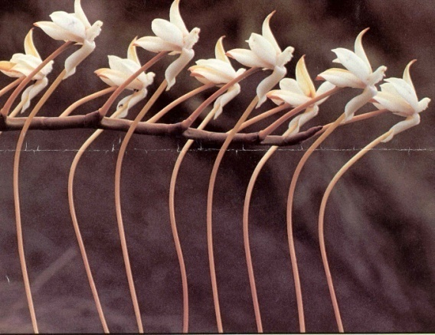
Brian O’Meara and NESCent Working Group:
Species Selection:
Increased net diversification in some lineages
Lineages with higher diversification:
Corolla present
Bilateral symmetry Likely Increase pollination precision
Reduced stamen number
M. Grandiflora
Ancestral
Sesquipedale
Derived
But the distribution of traits is far from the expected equilibrium

Slide 43
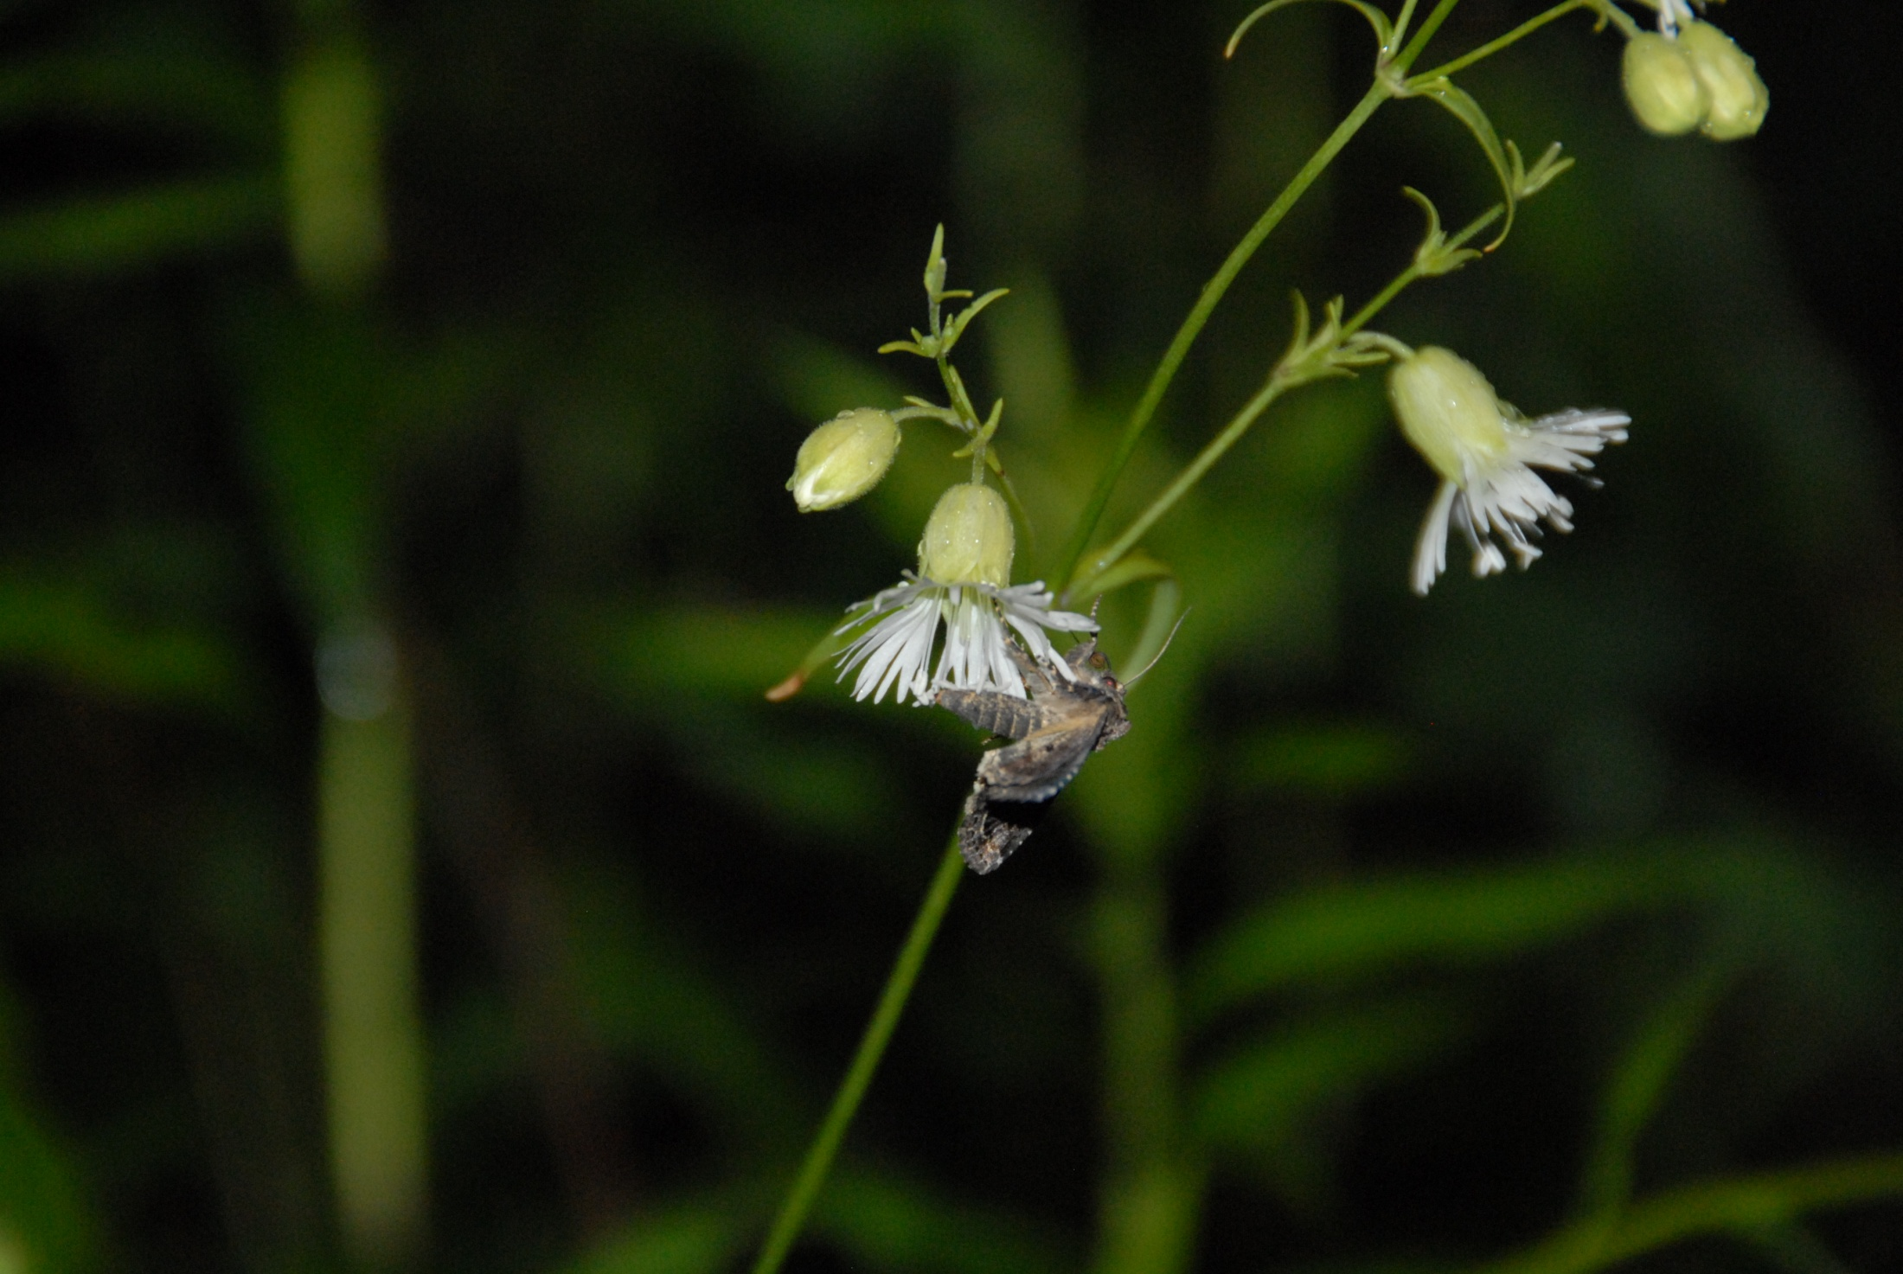
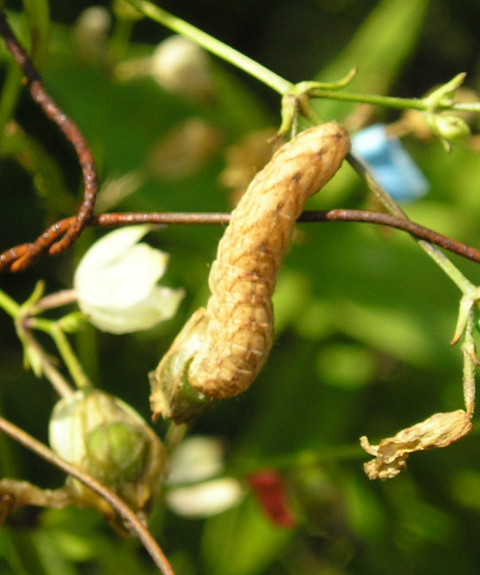



Ecological Determinants of Interaction Outcomes (Sideways Perspective)
(+) Mutualistic interaction or (-) Parasitic interaction
Silene stellata –Hadena ectypa interaction is facultative
Strict Mutualists:
Noctuidae, Notodontidae
Arctiidae
Larger than H. ectypa
Autographa
precationis
Feltia herilis
Amphipoea americana
Reynolds et al. 2012
Kula et al. 2013 and submitted
Notes:
Autographa precationis, Amphipaea americana, Feltis herilis

Slide 44


Future Directions:
What is maintaining the interaction?
1. Evolutionary approaches:
Does H. ectypa produce conflicting selection pressures through male and female reproductive success? (Sexual Conflict?)
Male Phase
Female Phase
(Zhou, Zimmer & Dudash)
Notes:
In Abby’s thesis ctl was associated with both pollination ~ fruit initiation and oviposition - resultant predation
Conflicting selection pressures are exerted when the same plant trait is selected for in both positive and negative directions.
A widely cited example is .....
Pollinating seed predators have both positive and negative effects on host plant reproduction.

Slide 45
Future Directions:
2. Ecological approaches:
Dynamics of a Mutualism-Parasitism Food Web Module
Mutualistic
Pollinators
Hadena ectypa
Seed eating pollinator
(-?) (+?)
(+,+) (+,?)
Silene stellata
= non trophic service
= indirect effects
(Holland & Dudash)
Notes:
Interspecific interactions rarely occur in isolated pairwise forms, but are embedded in food webs as components of more complex multi-species interactions that range from direct density-mediated consumer-resource interactions to indirect trait-mediated interactions. Compared with classic studies of food web modules involving predation and competition (e.g. intraguild predation, apparent competition, food chains), food web dynamics that include direct pairwise mutualisms are poorly understood. Integrating consumer-resource mutualisms into the communities of multi-species interactions is transforming traditional studies of food webs through new theoretical findings. First, our understanding of mechanisms resulting in indirect mutualisms have greatly improved by recognizing intraguild and consumer-resource aspects of food web modules. Second, theoretical analyses of food web modules that entail mutualism have revealed novel food web dynamics. Specifically, the density-mediated indirect interaction of 'apparent predation' arises whereby increases in parasitic consumer density have negative effects on mutualistic consumer density and increases in mutualistic consumer density have positive effects on parasitic consumer density, as mediated by changes in the density of their shared resource. Our proposed research will empirically test apparent predation and indirect intraguild mutualism as two competing hypotheses for the ecological persistence and dynamics of the food web module entailing Silene stellata (Caryophyllaceae) plants, and two groups of pollinators, namely purely mutualistic moth pollinators and the pollinating seed-parasite Hadena ectypa (Noctuidae). This system is ideal because the interactions are obligate for the specialized pollinator and facultative for the copollinators and plant, and the relative frequency of the two pollinator groups varies naturally during the season. We will experimentally decompose the food web module into its component subsystems to examine the population dynamics of pairwise consumer-resource interactions and the emergent dynamics of the food web module as a whole. Our research approach is multi-faceted, including integrative methodologies of manipulative factorial experiments, natural experiments employing structural equation modeling, and the integration of existing theory with empiricism using computational techniques for model fitting, parameterization, and model selection.
We will empirically test apparent predation and indirect mutualism using a food web module entailing indirect interactions between mutualistic (N₂) and parasitic (N₃) consumers that both exploit a basal mutualistic species (N₁) (Fig. 1c). The food web module as a whole is characterized by subsystems of direct and indirect consumer-resource interactions.
First, direct consumer-resource interactions of the (N₂,N₁)-mutualism (+,+) occur between S. stellata plants (Ss=N₁) and multiple nocturnal copollinating moth species (Poll=N₂) (Reynolds et al. 2009). This (N₂,N₁)-mutualism includes moth consumption of floral nectar supplied by S. stellata plants (Ss=N₁), depicted by a solid line with the arrow pointing from N₁ to N₂. The non-trophic service of moth pollination is depicted by a dotted line with the arrow pointing from N₂ to N₁, which enhances fruit production.
Second, direct consumer-resource interactions of the (N₃,N₁)-parasitism (+,−) occur between H. ectypa (He=N₃), a pollinating seed-parasitic moth, and S. stellata plants (Ss=N₁). The potential positive effects on plants via pollination are depicted by a dotted line with the arrow pointing from N₃ to N₁. The solid line with the arrow pointing from N₁ to N₃ depicts negative effects of larval consumption of flower and fruit resources on plants. Studies thus far indicate that this is a parasitic interaction (Reynolds et al. 2012).
Third, indirect (N₂,N₃)-interactions occur between moth pollinators (Poll=N₂) and the pollinating seed-parasites (He=N₃), as depicted by a dashed line with a double-sided arrow between N₂ and N₃. Indirect (N₂,N₃)-interactions are mediated by changes in flower and fruit resources of the plant (Ss=N₁) due to the (N₂,N₁)-mutualism and the (N₃,N₁)-parasitism. The indirect (N₂,N₃)-interactions take the form of apparent predation or indirect intraguild mutualism (?<--->?), depending in part on how (N₃,N₁)-interaction outcomes (+,?) vary with the community context of the food web module.
What are the density-dependent functional responses, pairwise dynamics and interaction outcomes of the purported (N₂,N₁)-mutualism between (Poll=N₂) and (Ss=N₁)? How do (N₂,N₁)-dynamics feedback on the (N₃,N₁)-parasitism and contribute to indirect (N₃,N₂) interactions by enhancing fruit resources of N₁ available to larval parasitism of N₃?
What are the density-dependent functional responses, pairwise dynamics and interaction outcomes of the (N₃,N₁)-parasitism between (He=N₃) and (Ss=N₁)? How do (N₃,N₁)-dynamics feedback on the (N₂,N₁)-mutualism and contribute to indirect (N₃,N₂) interactions by decreasing flower and fruit resources of N₁ via larval parasitism of N₃?
What is the nature of indirect (?<--->?) interactions between N₂ and N₃, namely can the indirect interaction be characterized as apparent predation or indirect mutualism?
Through research objectives(1-3) we also ask how does the ecological persistence of the food web module depend upon and vary with N₂ and/or N₃ dynamics and associated interactions with N₁ (clearly, the module depends on N₁)?

Slide 46



Genetic Rescue:
inbreeding vs outbreeding depression?
shawneeaudobon.org
Ohiodnr.com
Prairie Chicken
Lakeside Daisy
Florida panther
Outbreeding Depression
Should we be concerned?
floridapanther.com
Notes:
Provenance, local adaptation
Hapsburg 33 percent display a specific deformityï¿½lumbosacral transitional vertebraeï¿½which can cause full or partial paralysis of the rear legs and tail, as well as back pain. It is a condition also seen in domestic dogs. Other malformations were found in the wolves as well.

Slide 47

Genetic Rescue
To Date:
Decision tree for predicting outbreeding depression
and utilizing genetic rescue
(Frankham et al. 2011, Conservation Biology)
Implications of species concepts for genetic rescue
(Frankham et al. 2012, Biological Conservation)
Future:
Textbook on Genetic Rescue
Primer on Genetic Rescue (for managers)
Research to investigate breeding strategies to reduce
inbreeding for captive populations
Black-footed Rock Wallaby Recovery Program
Mark Eldrige, Australian Museum
Notes:
Decision TREE

Slide 48

Synthesis
Input of mutation
Elegance of natural selection
Multi-trait evolution has consequences for diversification and species selection
Ecological context determines interaction
outcomes
Genetic rescue

Slide 49







Acknowledgements
Master’s Students (both with professional science related careers):
Holly Williams, Tanya Finney
Ph. D. Students (all with academic appointments):
Richard Reynolds, Sylvana Martén-Rodriquez, Abby Kula
Current Ph. D. Students:
Sara Konkel, adaptive significance of color variation (with M. Dudash)
Frank Stearns, mutations and adaptive landscapes
Carolina Diller, pollinator-mediated selection
Andy Simpson, paleo-botanical perspective on dispersal sydromes (with S. Wing)
Juannan Zhou, sexual conflict (with M. Dudash, E. Ziimmer)
Postdoctoral Supervision (6 have academic appointments):
Laura Galloway, Martha Weiss, Eric Nagy, Stanley Spencer, Hans Stenøien, Johanne Maad, Matt Rutter, Joe Hereford
Undergraduates & High School Student Co-authors (7 with or currently obtaining PhD):
Julie Cridland, Cynthia Hassler, George Cheely, Chris Hardy, Peter Stevens, Jody Westbrook, Chris Williams, Sasha Rhodie, Dean Castillo, Kate Fenster
Most Influential Collaborators (current):
Douglas Schemske (MSU), Kermit Ritland UBC), Spencer Barrett (UToronto), E. Zimmer (Smithsonian), James Thomson (UToronto),
Shuang Quan Huang (Wuhan), Jon Agren (Uppsala), Thomas Lenormand (CNRS), Rick Ree and Deren Eaton (Field Museum),
Eric Imbert (Montpellier), Pam Diggle (UConn), Jeff Conner (MSU), Lawrence Harder (Calgary), Angie Roles (Oblerlin College),
Richard Reynolds (University of Alabama Birmingham Medical School), Silvana Marten-Rodriguez (Inst. Ecology, Xalapa), Matt Rutter (COC),
Frank Shaw (Hamline), Ruth Shaw (Minnesota), Scott Armbruster (UAF, Portsmouth), Outi Savolainen (Oulu), John McKay (CSU),
Stephen Wright (University of Toronto), John Stinchcombe (University of Toronto), Brian O’Meara (UTK), Stacey Smith (Univ of Colorado),
Robert Markowski (GorTex), Stefan Dotterl (Univ of Bayreuth), Nat Holland (Univ. Houston), Arjan Biere (NIE),
Detlef Weigel (Max Planck Tubingen), Michele Dudash (UMD, NSF)
Mountain Lake Biological Station
Notes:
49

Slide 50
Leadership Style
Transparent
By example
Experimental (track progress and outcomes)
Vigorous and informed discussion
Foster dialog, collaboration, creativity
Remove obstacles
Create resources
Advocate

Slide 51
Vision
Bifocal
Goal:
Top 10 graduate program
Exceptional record of outreach
Exceptional opportunities for undergraduate research
Forefront of new pedagogies
Leverage
Collaborative and Collegial
College, Campus
Oak Ridge
NIMBioS

Slide 52
Vision
Establish Departmental Identity
Natural history foundation within conceptual framework
Collections
Infrastructure, digitization
Public Outreach
Leverage collections citizen science initiatives
Board: Community and Alumni
Undergraduate Education
Continue innovations, use field station (also post-bac)
Leverage for NSF STEM initiatives, REU, HHMI

Slide 53
Vision
Graduate Education
Recruitment
Hands-on
Better funding (training grants)
Development
Pre-summer funding
Strategic use of GTA
More research assistanships
Professional standards course
DDIG/GRFP training
Core course
GSA

Slide 54
Vision
Post Doctoral Fellowships
Dual role
train graduate students/bridge labs
Career development
professional counseling, teaching

Slide 55
Vision
Faculty
Here
Mentor
Assistant level: research, teaching dossier,
strategic service
Associate level: plan for accelerated promotion
Advocate
Future Recruits
Great opportunity
Female and other under-represented faculty
Depth and breadth (if strategic)
Premium on collaboration
Joint appointments

Slide 56
Vision
New Programs
$
Priority is graduate student enhancement
Fund raising (use boards)
Campus (promoting EEB raises other units)
Departmental effort (reward effort)
Staff
Employee-Employer relationship
Face of department
Freedom to explore roles and introduce efficiencies
Unleash potential
Why do I want to do this?
Notes:
Passionate for the mission of universities, being a head of a department comes as close to faciliating the universities mission as I think possible. Knowledge creation and its dissemination. Well funded, poised to lots of creative science in the next 10 years but I want other challenges as well. As my reserch has become more collaborative I realize how much I enjoy collaborative approaches to solving problems and effective administration is just that, finally I like administration, I am good at administration and that that is a good combination for wanting to do something I also treat it as an interesting puzzle, but one that has important implications for the unit I serve.

Slide 57
Hadena adult activity varies spatially and temporally
Proportion flowers with eggs
0.4
0.3
2005
Rogers
0.2
2006
2007
0.1
2008
0
0.0
Meadow Woodland Wind Rock
Three S. stellata Field Sites
37
(Reynolds et al. 2012 Oecologia)

Slide 58
Spatial and Temporal (between years) Variation in Seed Predation & Fruit Set
Proportion seed
predation
b
0.4
b
b
0.2
a
a
a
0.0
Meadow
Proportion fruit set
a
0.6
a
Woodland
ab
b
Wind Rock
b
0.4
b
0.2
0.0
2005 2006
Reynolds et al. 2012 Oecologia

Slide 59
Ecological Conditions – Density
Pollination - 2008
a
ab
b
b
High density
Low density
Pollination highest in high density areas for visited flowers.
Notes:
These data are from H. ectypa only because only four samples were collected from co-pollinators.
Hadena moths probably brought an initial load of pollen from the non-isolated area but then visited flowers in the isolated area repeatedly, quickly depleting available pollen.

Slide 60
Ecological Conditions – Density
Seeds per fruit, oviposition and predation - 2009
a
High density
Low density
Pollinator exclusion
b
b
Plants at high density had the highest seeds per fruit.
Oviposition was similar between density levels, BUT predation was higher at low density.
a
b
Notes:
Pollen deposition rates were much lower IN ISOLATION –likely the cause of lowered seed set. Additionally, the seed set data came from individual plants that likely suffered even lower visitation and pollen deposition rates than plants in the small patches where I observed moths and collected stigmas for pollen deposition data.
Oviposition rates were similar between the areas, but predation was higher for isolated plants, mostly we think, because larvae are “trapped” on the isolated plants and so consume more of the flowers or fruits that are at less desirable stages. They prefer flowers and unhardened fruits and they require 30 or so flowers or fruits to develop.

Slide 61

Mutation Effect Relative to Environmental Variance
Resampling
of Premutation
Founder
Frequency
MA Lines
MA line Fitness and Premutation Fitness

Slide 62

Future Directions
Mutation-Fitness
Map
Quantify selection
through Male RS
Silene stellata-Hadena ectypa interaction
(mutualism evolution, food web theory sexual conflict)
Many other floral
characters to examine
floridapanther.com
Florida panther
Epistasis and species recovery plans

Slide 63

How does Hadena ectypa influence reproductive success of Silene stellata?
(+) Mutualistic interaction or (-) Parasitic interaction
Maintenance of interaction:
Ecological approach: food web dynamics (with N. Holland)
Evolutionary approach: conflicting selection, fragrance evolution
Notes:
The ecological context that makes this interaction + vs –
Food web dynamics
Sexual Conflict using paternity approahces

Slide 64

Stochastic simulations of angiosperm evolution using four different models for two character combinations:
M. grandiflora
A. sesquipedale
Notes:
Magnolia grandiflora, Angraceum sesquipalde
Results are reported for two character combinations, the ancestral state (perianth present, regular symmetry, numerous stamens) and the focal state (perianth present, bilateral symmetry, few stamens). Each simulation is represented by a gray line, and the mean and 95% confidence interval for all simulations are indicated by the red solid and dashed lines, respectively. The distribution of final proportion of taxa with a character-state combination for each set of simulations is shown in the histogram, and the actual proportion in the dataset is indicated with the black bar.

Slide 65
The end

Slide 66

Does selection act
on traits alone
or in combination?
Traits | S. caroliniana | S. virginica | S. Stellata
Color | purple -white | red | white (fringed)
Flower position | upright | horizontal | horizontal
Inflorescence architecture | dense short | diffuse tall | intermediate tall
Fragrance | none | none | moderate, night
Corolla length (mm) Stigma & anther exer. | 15-22 slight | 20-28 great | 8-11 intermediate
Corolla tube width | narrow | intermediate | wide (bowl)
Nectar: amount and composition Anther dehiscence | 2 ul 43% sucrose Day | 15 ul 23% sucrose Day | 1 ul 28% sucrose Night
Pollinator | Large Bee & Moth | Hummingbird | Nocturnal Moth
 |  |  | Reynolds et al. 2009
Notes:
66
Our work with Silene. Can we confirm that selection is acting on trait combinations

Slide 67
Hummingbird pollinated Silene virginica:
Consistent evidence for multitrait phenotypic selection
(Reynolds et al. 2010)

Slide 68
Detecting Pollinator Mediated Selection with Comparative Approaches
1. Pollination and breeding system evolution in Gesnerieae (Caribbean)
Silvana Martén-Rodriguez et al. 2008, 2009, 2010
Notes:
Monophylectic radiation, floral trait transitions were correlated to pollination system transitions, and low hummingbird visitiation rates led to pollen limitation and evolution towards more generalized pollination systmes and reproductive assurance, continuing with island mainland comparisons, interesting to do with island size

Slide 69



Detecting Pollinator Mediated Selection with Comparative Approaches
2) Community Sorting and Homoplasy in Tibetan Pedicularis
Eaton et al, Ecology, 2012
Notes:
Pedicularis shares same pollinators, Comparative approaches and pollination Community Sorting in islands
Deren Eato

Slide 70

“As all the parts of a flower are coordinated…” (Darwin, 1862)
“A flower is … a harmonious unit.” (Stebbins, 1951)
Only a subset of floral trait
combinations are observed
Wright 1988
Ancestral Trait State | Derived Trait State | #
Corolla present | Corolla absent | 1
Petals separate | Petals fused | 2
Symmetry radial | Symmetry bilateral | 3
Stamens many | Stamens few | 4
Carpels separate | Carpels fused | 5
Seeds many | Seeds few | 6
Placentation axial | Placentation other | 7
Ovary superior | Ovary inferior | 8
Notes:
is possessed by twelve groups, one of
them containing more than twenty genera.
Near the upper right hand corner,
in the square formed by the vertical column
headed 1467 and the horizontal one
headed 5, appears the number 24 surrounded
by one thick circle and two thin
ones. This indicates that the condition
monochlamydy, polysepaly, actinomorphy,
reduction in stamen number, syncarpy,
reduction in ovule number, basal placentation,
and hypogyny or perigyny, is possessed
by twenty-four groups, seven of
which contain twenty or more genera.
The square in the lower right hand corner
contains no number, but only a single
horizontal line. This indicates that the
advanced condition in respect to all eight
characters is not realized by any groups,
and that this condition is probably unadaptive
or poorly adaptive because it
combines the absence of ~etalsw ith the
presence of a zygomorphic flower.
Obviously, this chart could be made

Slide 71
Top ten models (ranked by AIC weight) from maximum likelihood focal combination analysis.
AIC weight | Cumulative AIC weight | Focal combination | Diversification | Transitions
0.274 | 0.274 | 0x11xx = Corolla present, Symmetry bilateral, Stamens few | In model | Not in model
0.245 | 0.519 | xx1xxx = Symmetry bilateral | In model | In model
0.202 | 0.721 | xx1xxx = Symmetry bilateral | In model | Not in model
0.128 | 0.849 | xx11xx = Symmetry bilateral, Stamens few | In model | Not in model
0.090 | 0.939 | 0x1xxx = Corolla present, Symmetry bilateral | In model | Not in model
0.024 | 0.963 | xx1xxx = Symmetry bilateral | In model | In model
0.014 | 0.977 | 0x11xx = Corolla present, Symmetry bilateral, Stamens few | In model | In model
0.009 | 0.985 | xx1xxx = Symmetry bilateral | In model | In model
0.003 | 0.988 | 0x1xxx = Corolla present, Symmetry bilateral | In model | In model
0.003 | 0.991 | 0x11xx = Corolla present, Symmetry bilateral, Stamens few | In model | In model
… approximately 19,500 models evaluated
No effect: petals separate/fused, carpels separate/fused, ovary superior/inferior
Corolla Present, Bilateral Symmetry Stamens Few effect:
Diversification and Transition Rates

Slide 72


Hummingbird Response to Experimental Manipulation of Traits
Five Way Trait Interaction:
Silene virginica
Silene caroliniana
Example of trait interaction
Notes:
All conditional and everything else,
Expected based on single trait, then carolina

Slide 73
 | Model | K speciation | K extinction | λ_{F} | λ_{N} | μ_{F} | μ_{N}
1. | Yule | 1 | 0 | λ_{F} = λ_{N} |  | 0
2. | Two-rate Yule | 2 | 0 | λ_{F} | λ_{N} | 0
3. | Simple birth-death | 1 | 1 | λ _{F} = λ_{N} |  | μ_{F} = μ_{N}
4. | Two birth, one death | 2 | 1 | λ_{F} | λ_{N} | μ_{F} = μ_{N}
5. | One birth, two death | 1 | 2 | λ_{F} = λ_{N} |  | μ_{F} | μ_{N}
6. | Free | 2 | 2 | λ_{F} | λ_{N} | μ_{F} | μ_{N}
Notes:
Diversification rate models for focal and non-focal states. K is the number of free parameters (rates) in the model. Each model contains up to four different rates (λ_{F}, λ_{N}, μ_{F}, μ_{N}) where λ is the speciation rate, μ is the extinction rate and “N” and “F” denote the non-focal and focal states, respectively

Slide 74


Weighted model average of the 10 best-fitting models (99% of AIC) comprising three characters: (corolla presence/absence,
stamen number and floral symmetry)
Radial
Bilateral
= higher value
= middle value
= lower value
O’Meara, Smith et al.
Notes:
PRECISION CHARACTERS
Here we show our results.
Node size indicates number of taxa
Color indicates rate, hotter = higher.
Look at Nodes look at arrows
This represents the 8 segregated nodes
These characters associated with precise pollination. RI and pitons of evolution

Slide 75

Ancestral Trait Reconstruction of the Eight Trait Combinations
000
Combo 000
cor pres, radial, many S (51 taxa)
cor pres, radial, many S (51 taxa)
Combo 001
cor pres, radial, few S (197 taxa)
Combo 010
cor pres, bilateral, many S (2 taxa)
Combo 011
001
cor
cor pres, bilateral, few S (178 taxa)
Combo 100
011
cor abs, radial, many S (11 taxa)
Combo 101
cor
cor abs, radial, few S (23 taxa)
Combo 110
cor
cor abs, bilateral, many S (0 taxa)
Combo 111
cor
cor abs, bilateral, radial, few S (4 taxa)
O’Meara, Smith et al.
Notes:
ATR, note 000, then 001, then 011, looks like increase in diversification , trait combinations

Slide 76
Female Reproductive Success
Petal Size DisplayHeight DisplaySize CorollaTubeLength StigmaExertion CorollaTubeDiameter
Var PS | Cov(PS, DH) | Cov(PS, DS) | Cov(PS, CTL) | Cov(PS, SE) | Cov(PS, CTD)
 | VarDH | Cov(DH, DS) | Cov(DH, CTL) | Cov(DH, SE) | Cov(DH, CTD) Positive**
 |  | VarDS | Cov(DS, CTL) | Cov(DS, SE) | Cov(DS, CTD)
 |  |  | VarCTL | Cov(CTL, SE) Negative** | Cov(CTL,CTD)
 |  |  |  | VarSE | Cov(SE, CTD)
 |  | Reynolds et al. Evolution 2010 |  |  | VarCTD
CorollaTubeDiameter StigmaExertion CorollaTubeLength DisplaySize DisplayHeight Petal Size
Conclusion:
Correlational selection on part of the Gamma Matrix
Notes:
We did observe some consistent selection to increase trait covariation. Talk about biology. Of one cell. TL and SE
But only a subset of the possible selection gradients on the covariances were significant

Slide 77
Multivariate selection in S. virginica: Canonical analyses
Eigenvalues (λ_{i}) and eigenvectors (M_{i}) of the 6 latent axes
with statistically significant nonlinear selection.
Reynolds et al. Evolution 2010
Year | Fitness proxy | M_{i} | Tube Length | Petal Length | Petal Width | Tube Diameter | Stigma-Exerstion | Display Height | λ _{i} | p- value
1994 | Fruit set | M2 | 0.482 | 0.242 | 0.707 | -0.011 | 0.355 | -0.288 | -0.338 | 0.046
1994 | Seed set | M3 | -0.598 | -0.244 | -0.031 | -0.091 | 0.463 | 0.599 | -0.214 | 0.036
1995 | Fruit set | M6 | -0.450 | -0.469 | 0.346 | 0.127 | 0.443 | 0.495 | 0.668 | 0.021
2003 | Fruit set | M3 | 0.145 | 0.500 | 0.102 | -0.745 | 0.401 | -0.044 | -0.200 | 0.026
2005 | Seed set | M2 | 0.180 | -0.029 | -0.575 | -0.464 | 0.384 | 0.524 | -0.196 | 0.007
2006 | Seed set | M1 | 0.063 | -0.299 | 0.681 | -0.599 | 0.138 | 0.254 | -1.25 | 0.022
P-values are from a permutation test (Reynolds et al. 2010)
Correlational Selection:
6/16 Fitness Proxy/Year Combinations
+ 5 more 0.05 < p < 0.10
Notes:
We get a very different picture from the canonical analysis.
Higher order interactions.
Phenotypic selection on floral trait combinations was a common feature from our data, which is exactly what is expected under the pollination syndrome concept, the independent evolution of independent suites of correlated characters. Ours study provides about the strongest evidence for selection acting on trait combinations.
Trivial as it may seem to attempt the full second-order polynomial model in this case, it is necessary to estimate all these terms in order to get a complete picture of the slope and curvature in the selection surface. Canonical analysis of gamma enabled us to detect curvature on at least one latent axis in 5 of the eight years.
Pw and td

Slide 78



Experimental Approach:
What combinations of traits in artificial arrays of flowers do hummingbirds prefer to visit?
Trait combinations from S. virginca, S. stellata, S. caroliniana
  Presentation:
    Horizontal or upright
  Flower height:
    50cm or 25cm
  Inflorescence architecture:
    Clumped or diffuse flowers
  Tube diameter:
    Wide (8.0mm) or narrow (4.0mm)
  Flower color:
    Red, pink, or white flowers
2 x 2 x 2 x 2 x 3 = 48 Trait Combinations
Notes:
48 combinations
HB visitation is correlated with male and female RS

Slide 79

17 – 20 % Amino Acid Substitutions Due to Positive Selection*** (adapted from Fay, 2011 by Herron and Freeman 2013)
(p_{N}/p_{S})
a
= 1 -
(d_{N}/d_{S})
*** Mechanism Unknown

Slide 80
How to document the pattern of natural selection on a multivariate character (the flower)?
Quantify Phenotypic Selection
Experimental Manipulation Approaches
Comparative Approaches
Notes:
80
3 approaches

Slide 81


Phenotypic Selection in the Field: Silene virginica
8 year study (1992-95, 2002-06)
Female Reproductive Success
(Total Fruit & Seed)
Attraction
Petal Size (Length x Width)
Display Height
Display Size (# Flowers)
Mechanics of Pollen Deposition
Corolla Tube Length
Stigma Exsertion
Corolla Tube Diameter
Covariates
Flower Number
Various Vegetative Traits
150-300 individuals/year
(Reynolds et al., Evolution 2010)
Mtn. Lake Biol. Station
Notes:
81
This is the general procedure for our field phenotypic studies documenting pollinator mediated selection through female RS to date. We quantified the relationship between phenotypic variation and covariation with female RS. We examined traits associated with attraction, read, and traits governing the position of the hummingbird relative to male and female parts.
Pursuing the same types of analyses but taking into account m RS through the use of paternity analyes utilizing microsat markers.

Slide 82
Phenotypic Selection: Analytical Approach (6 Traits)
Female Reproductive Success Lande-Arnold (1983), Phillips & Arnold (1989)
Corolla tube length, nectar-stigma distance, corolla tube diameter, petal length, petal width, inflor. Ht.
1.
1st Approach
2.
3.
4.
2nd Approach
(Canonical Analysis)
5.
6.
(Reynolds et al., Evolution 2010)
Notes:
We saw consistent directional selection, but here I want to focus on detecting selection to increase or decrease the covariation between traits. We focus on the Gamma matrix of selection gradients where the diagonal is a measure of stabilizing selection on each trait and the off-diagonal is the selection gradient on the covariance between traits.
Most studies do not detect correlational selection perhaps because of adhoc nature of defining trait interaction in terms of only 2 traits, and also it is difficult to interpret correlations when embedded within other correlational selection estimates.
Canonical analysis of gamma is a powerful tool in studies of phenotypic selection because, rather than making ad hoc explanations for each correlational selection gradient, the question can be distilled to whether nonlinear selection is occurring on latent axes describing selection jointly on the original floral traits.
==
Long-term selection on floral trait combinations may lead to the evolution of positive or negative genetic and phenotypic covariance of pairs of floral traits (Phillips and Arnold 1989). However, correlational selection is often not estimated, regardless
of taxa and trait (Kingsolver et al. 2001; Blows and Brooks 2003). Lack of evidence for correlational selectionmay reflect the
situation that when many traits are analyzed, correlational selection between a given pair of traits can be difficult to interpret in the context of the set of all possible correlational selection estimates. However, methods exist from response surface methodology to simplify the situation. Phillips and Arnold (1989), and later elaborated on by Blows and Brooks (2003) and Blows (2007), have
indicated that an efficient way to detect curvature in the selection surface (Phillips and Arnold 1989), is to conduct a canonical transformation of the matrix (gamma) containing the correlational and quadratic (stabilizing and disruptive) selection gradients. Canonical analysis of gamma is a powerful tool in studies of phenotypic selection because, rather than making ad hoc explanations for each correlational selection gradient, the question can be distilled to whether nonlinear selection is occurring on latent axes describing selection jointly on the original floral traits. If the transformation yields estimates similar to the original quadratic estimates then one can interpret that correlational selection is minimal. Otherwise, correlational selection is prevalent even if any single correlational selection gradient is not significant. We apply this underutilized approach here in our investigations of selection on Silene virginica (Caryophyllaceae) floral traits. As far as we are aware, no other study has used this multivariate approach to quantify phenotypic selection on traits that define pollination syndromes.

Slide 83
Experimental Approach:
Array Design
3
4
2
1
*Trial = approx. 25 plant visits in a block or flowers were empty of nectar
*30 minutes - 90 minutes (four observers)
*Total of 28 Trials run
2072 Plant visits
Notes:
Each of the points represents one of the 48 combinations

Slide 84
Response Variables:
# of visits per plant
= proxy of fitness
S. virginica: Red, Tall, Diffuse, Horizontal, Narrow
S. caroliniana: Pink, Short, Clump, Vertical, Narrow
S. stellata: White, Tall, Clump, Horizontal, Wide
+ 45 other combinations
Notes:
Note flowers and hummbird choosing

Slide 85
Model Selection Approach:
Best-subsets regression analysis of main and interactive effects
.
Response variable:
Plant visits by hummingbirds AIC score comparisons
 | Number of Variables in Best Model
 | 1 | 2 | 3 | 4 | 5 | 6 | 7 | 8 | 9 | 10
Intercept | X | X | X | X | X | X | X | X | X | X
FLHT |  | X | X | X | X | X | X | X | X | X
FC2 |  |  |  |  |  | X | X
PRES |  |  | X | X | X |  |  | X | X | X
IA |  |  |  |  |  |  |  |  |  | X
TW.FLHT |  |  |  |  |  |  | X
FLHT.FC2 |  |  |  |  |  |  |  |  | X
FLHT.PRES |  |  |  |  |  |  |  | X | X | X
FLHT.IA |  |  |  |  |  |  |  |  |  | X
FC2.PRES |  |  |  |  |  | X | X
FC1.IA |  |  |  |  | X | X | X | X | X
FC2.IA |  |  |  |  |  |  |  | X | X
FLHT.FC1.IA |  |  |  |  |  |  |  |  |  | X
FLHT.FC2.IA |  |  |  |  |  |  |  |  |  | X
FLHT.FC2.PRES.IA |  |  |  |  |  |  |  | X | X | X
PRES.IA.FLHT.TW.FC1 |  |  |  | X | X | X | X | X | X | X
Fenster, Reynolds, Markowski, & Dudash in prep
Notes:
We used best-subsets regression to determine two things, (1) what subset size of predictors was most important for explaining variation in hummingbird visitation and (2) what order of entry into the model were the main effects vs interaction effects
In this section, we learn about the best subsets regression procedure (or the all possible subsets regression procedure). While we will soon learn the finer details, the general idea behind best subsets regression is that we select the subset of predictors that do the best at meeting some well-defined objective criterion, such as having the largest R² value or the smallest MSE.
the general case, the AIC is where k is the number of parameters in the statistical model, and L is the maximized value of the likelihood function for the estimated model. Given a set of candidate models for the data, the preferred model is the one with the minimum AIC value. Hence AIC not only rewards goodness of fit, but also includes a penalty that is an increasing function of the number of estimated parameters. This penalty discourages overfitting (increasing the number of free parameters in the model improves the goodness of the fit, regardless of the number of free parameters in the data-generating process).
AIC is founded in information theory. Suppose that the data is generated by some unknown process f. We consider two candidate models to represent f: g₁ and g₂. If we knew f, then we could find the information lost from using g₁ to represent f by calculating the Kullback–Leibler divergence, D_{KL}(f ‖ g₁); similarly, the information lost from using g₂ to represent f would be found by calculating D_{KL}(f ‖ g₂). We would then choose the candidate model that minimized the information loss.
We cannot choose with certainty, because we do not know f. Akaike (1974) showed, however, that we can estimate, via AIC, how much more (or less) information is lost by g₁ than by g₂. It is remarkable that such a simple formula for AIC results. The estimate, though, is only valid asymptotically; if the number of data points is small, then some correction is often necessary (see AICc, below).

Slide 86
Does selection act on trait combinations?
Yes
Contemporary selection on S. virginica is correlational
(Reynolds et al. Evolution 2010)
And Yes
Experimental manipulation of floral traits demonstrate hummingbirds visit based on floral trait combinations
Notes:
86
Pollinator mediated selection
We have provided evidence that wonderful corrleation of traits, known as pollination syndromes, reflect selection acting to build these combinations

Slide 87
Stebbins 1951 in a nutshell:
“A flower is … a harmonious unit.”
For 8 floral traits examined two states.
Expect 2⁸ different combinations found in angiosperms.
But observed only 86/256 possible combinations & 200 of the 400 families represented 12 different combinations!
Uneven distribution.
“The characteristic [combinations] of many genera and
families [represent] peaks.”
Notes:
Suggests that certain traits are only adaptations when expressed with certain specific trait combinations, selection favors the simultaneous occurrence of certain traits. Selection increases the association or correltation between these traits talk about traits, inferior superiour, fusion of petals separate petals, etc.

Slide 88
Binary State Dependent Speciation
& Extinction (Markov Models)
Maddison et al. 2007
q01
r0
0
1
r1
q10
Ancestral (root) Derived
two states are 0 and 1
r is the diversification rate for each (speciation minus extinction)
q01 and q10 = transition rates between character states
Notes:
Explain figure

Slide 89
Extending BiSSE to Trait Combinations:
Six Major Angiosperm Traits Scored
(2⁶ combinations = 64 combos)
Ancestral Trait State | Derived Trait State | Combo Score for Derived Trait State
Corolla present | Corolla absent | 1*****
Petals separate | Petals fused | *1****
Symmetry radial | Symmetry bilateral | **1***
Stamens many | Stamens few | ***1**
Carpels separate | Carpels fused | ****1*
Ovary superior | Ovary inferior | *****1
e.g.: Corolla present, Symmetry bilateral, Stamens few: 0*11**
Notes:
6/8 traits important for floral evolution, pollinator precision, pollen competion, draw attention to focal group concept
We aimed to estimate rates of gain and loss of each character state and character-state combination as well as the effect of these character transitions on diversification. To do this, we combined the recently developed binary state-dependent speciation and extinction (BiSSE) models (Maddison et al. 2006, FitzJohn et al. 2009) with a novel approach to exploring character state space. Given our six floral characters, we have 2⁶ or 64 character-state combinations, which can be portrayed as string of binary states, e.g. 000111 and 111000. Thus, combination 000001 corresponds to the ancestral state for all characters except for character 6, ovary position (Table 2). These 64 combinations can be viewed as a network with each combination (each vertex)
Within this framework, we explored a set of models to detect differential transition rates and/or diversification rates in focal states. In the Markov models used in these analyses, and generally in phylogenetics, it is assumed that in a given time instant only one state can change (Pagel, 1994; O’Meara, 2012). Thus, we only estimated transition rates between combinations differing by a single character (e.g. 000000 and 000001); all other transition rates were set to zero. In total the full model contains 64 x 6 or 384 possible transitions. After dividing the network into the focal and non-focal states (e.g. Fig. 1), we can consider how transition rates between the two regions might differ. Specifically, we tested five different transition rate models, which are listed in Table 3. For example, in model 4, lineages move into and out of the focal state at different rates (although transitions among all non-focal combinations proceed by a single rate (q_{NN}) as do transitions among focal combinations (q_{FF})). Thus, if the focal state was ****10, all transitions among all combinations lacking that state (e.g. 000000, 000001) would proceed at the rate q_{NN,} all transitions among all combinations having that state (e.g. 000010, 000110) would proceed at the rate q_{FF,} and transitions between these two regions of state space would proceed at rates q_{NF} (e.g. 000010→000000). and q_{NF} (e.g. 000000→000010).
We took a similar approach to testing for differential diversification of focal states. The BiSSE model separately estimates the two components of diversification rate, speciation rate (λ) and extinction rate (μ). We created six diversification models, which are listed in Table 4. These span more complex models with freely estimated speciation and extinction rates (model 6) to simple pure-birth (zero extinction) Yule models (model 1).
We tested all possible pairs of transition and diversification rates models (5 transition x 6 diversification for 30 total) using our dataset of 466 taxa and the single ML chronogram. These models are nested with respect to the most complex model examined (four transition rates, four diversification rates) but not always with each other. Thus, model fit was examined using the Akaike Information Criterion or AIC (Akaike, 1974). In total we examined 21,114 models across the 729 focal states and 30 differential diversification/transition models. We ranked the models using AIC and also computed model-averaged rates for all eight transition and diversification parameters by averaging the value across models weighted by the AIC value of the model. To determine how sensitive our results were to the specific maximum likelihood topology and branch lengths, we repeated the analyses across a set of 100 bootstrapped trees from RAxML (see above).
We don’t say this in the results!

Slide 90
Tree construction methods and
character mapping:
Generated branch lengths by randomly sampling 500 species from
GenBank based on clade size
1.7 megabases of sequence data (7 genes)
Supermatrix constructed with PHLAWD
RAxML
Constrained tree (APG and group knowledge)
40 fossils for calibration points
Determined trait states and trait state combinations
Mapped character states
Notes:
JEN BANK
Mega base = one million base pairs
1,700,000/500 = 3400 bp per species

Slide 91
Binary State Dependent Speciation
& Extinction (Markov Models)
Maddison et al. 2007
q01
r0
0
1
r1
q10
Ancestral (root) Derived
Series of bipartitions for 6 traits each with 2 character states:
For any character the state could be: 0, 1, or *
3⁶ bipartitions x 5 rate models x 6 transition models

Slide 92
Focal Groups and Bi-partitions
(developed by Brian O’Meara)
Corolla present, bilateral symmetry, few stamens
combined with 2³ = 8 other character states
Phenotypic Space Bi-partitioning Phenotypic Space

Slide 93
Transition Rate models for Focal and Non-Focal States
K is the number of free parameters in the model
 | Model | K | q_{NF} | q_{NN} | q_{FF} | q_{FN}
1. | Equal | 1 | q_{NF} = q_{NN} = q_{FF} = q_{FN}
2. | Inflow unique | 2 | q_{NF} | q_{NN} = q_{FF} = q_{FN}
3. | Outflow unique | 2 | q_{NF} = q_{NN} = q_{FF} |  |  | q_{FN}
4. | Inflow and outflow different | 3 | q_{NF} | q_{NN} = q_{FF} |  | q_{FN}
5. | Free | 4 | q_{NF} | q_{NN} | q_{FF} | q_{FN}
Each model contains up to four transition rates (q_{NF}, q_{NN}, q_{FF}, q_{FN}),
where “N” denotes the non-focal state and “F” the focal state. The rate q_{NF} is thus the rate of transitions from the non-focal to the focal state.
Notes:
Table 3. Transition rate models for focal and non-focal states. K is the number of free parameters (transition rates) in the model. Each model contains up to four different transition rates (q_{NF}, q_{NN}, q_{FF}, q_{FN}) where “N” denotes the non-focal state and “F” the focal state. The rate q_{NF} is thus the rate of going from the non-focal to the focal state.

Slide 94
Diversification rate models for focal and non-focal states
K is the number of free parameters (rates) in the model
Each model contains up to four rates (λ_{F}, λ_{N}, μ_{F}, μ_{N}) where λ is the speciation rate (units?), μ is the extinction rate (units?) and “N” and “F” denote the non-focal and focal states, respectively.

Slide 95
3⁶ bipartitions x 5 rate models x 6 transition models =
729 bipartitions x 5 rate models x 6 transition models =
= 19, 567 unique models
Models were ranked with AIC

Slide 96
Top ten models (ranked by AIC weight) from maximum likelihood focal combination analysis.
AIC weight | Cumulative AIC weight | Focal combination | Effect of Trait(s) on Diversification & Transition Rates (R>B, G=Equal)
0.274 | 0.274 | 0x11xx = Corolla present, Symmetry bilateral, Stamens few
0.245 | 0.519 | xx1xxx = Symmetry bilateral
0.202 | 0.721 | xx1xxx = Symmetry bilateral
0.128 | 0.849 | xx11xx = Symmetry bilateral, Stamens few
0.090 | 0.939 | 0x1xxx = Corolla present, Symmetry bilateral
0.024 | 0.963 | xx1xxx = Symmetry bilateral
0.014 | 0.977 | 0x11xx = Corolla present, Symmetry bilateral, Stamens few
0.009 | 0.985 | xx1xxx = Symmetry bilateral
0.003 | 0.988 | 0x1xxx = Corolla present, Symmetry bilateral
0.003 | 0.991 | 0x11xx = Corolla present, Symmetry bilateral, Stamens few
A
D
A
D
A
D
A
D
A
D
A
D
A
D
A
D
A
D
A
D
… approximately 19,500 models evaluated
No effect: petals separate/fused, carpels separate/fused, ovary superior/inferior
Corolla Present, Bilateral Symmetry Stamens:
Influence Diversification and Transition Rates
O’Meara, Smith et al.
Notes:
Top ten models (ranked by AIC weight) from maximum likelihood focal combination analysis. The focal combination is described as a string in which 0 and 1 indicate the ancestral and derived states for each character and “x” indicates that the state for that character could be either 0 or 1. The only characters identified by the models as part of focal states are corolla presence (character 1, 0=present, 1=absent), floral symmetry (character 3, 0=radial, 1=bilateral) and stamen number (character 4, 0=twice as many as merosity, 1=fewer). Model parameters include transition rates within and between focal areas (q_{FF}, q_{NN,} q_{FN}, q_{NF}) and diversification parameters (speciation rates, λ_{N}, λ_{F}; extinction rates μ_{N}, μ_{F}; net diversification rates r_{F}, r_{N}). Free = four diversification rates estimated, two/one = two speciation rates and one extinction rate estimated; complete description of models for diversification and transitions are in Tables S3, S4).

Slide 97

Simulated time to first appearance of each
combination of the three characters.
O’Meara, Smith et al.
Tall bars and short bars indicate the median and 95% confidence interval, respectively, based on 50 simulations.

Slide 98
Stochastic simulations of angiosperm evolution using four different models for two character combinations:
M. grandiflora
Contemporary
Frequency
Contemporary
Frequency
A. sesquipedale
O’Meara, Smith et al.
Notes:
Magnolia grandiflora, Angraceum sesquipalde
Results are reported for two character combinations, the ancestral state (perianth present, regular symmetry, numerous stamens) and the focal state (perianth present, bilateral symmetry, few stamens). Each simulation is represented by a gray line, and the mean and 95% confidence interval for all simulations are indicated by the red solid and dashed lines, respectively. The distribution of final proportion of taxa with a character-state combination for each set of simulations is shown in the histogram, and the actual proportion in the dataset is indicated with the black bar.

Slide 99
Conclusions
BiSSE (O’Meara et al. ):
Net Diversification
(Speciation – Extinction)
time
Flower Symmetry: Radial Radial Bilateral
Stamen Number: Many Few Few
Character Combinations
Trait combinations are important
Selection within species assembles the traits but this is rate-limiting
Selection among species based on trait combinations generates angiosperm diversity
O’Meara, Smith et al.

Slide 100
Within Year Variation: Fruit Set & Predation
2008
Initiated Fruit set, P=0.127
Predation, P < 0.001
Synchrony →
(Kula 2012)
Notes:
This figure…. Remember: low synchrony means that there was little or no overlap between oviposition and flowering, and high synchrony means that flowers and moths had a great deal of overlap.
Between year differences in synchrony – significantly higher proportion of flowers opening per period in 2009. PLUS 2009 oviposition was twice as high meaning there was twice the potential synchrony.
2008: plants with greatest synchrony (or overlap) with oviposition suffered the highest predation rate.
2009: plants with the greatest synchrony had the lowest predation

Slide 101

H. ectypa oviposition per flower and larvae per plant
Day of Year
(Kula 2012)

Slide 102
Within Year Variation: Fruit Set & Predation
2009
Synchrony: Initiated Fruit set:
Not significant both years
Synchrony – Predation:
Increase flowering synchrony 2009 > 2008
2008: positive association -> (-)
2009: negative association -> (+)
Egg deposition 2009>2008
Fruit maturation 2009>2008
Initiated Fruit set
P = 0.137
Predation
P<0.001
(Kula 2012)
Notes:
This figure…. Remember: low synchrony means that there was little or no overlap between oviposition and flowering, and high synchrony means that flowers and moths had a great deal of overlap.
Between year differences in synchrony – significantly higher proportion of flowers opening per period in 2009. PLUS 2009 oviposition was twice as high meaning there was twice the potential synchrony.
2008: plants with greatest synchrony (or overlap) with oviposition suffered the highest predation rate.
2009: plants with the greatest synchrony had the lowest predation

Slide 103



Ecological Conditions – Synchrony
Flowering Phenology:
Phenology and plant-insect interactions
Synchrony between flowering and pollinator or florivore activity
Notes:
Flowering pattern across two years – typical, common pattern, with a peak
Phenology is ….the pattern of recurring plant or animal life cycle stages.
Obviously the pollinator and seed predators have phenology, too, CLICK and if adults are flying early in the flowering season, we would expect to see larvae active later in the season.
CLICK
So how does the interaction outcome change? Does it vary throughout the season and between years?
Matches or mismatches can affect host plants positively (such as matches with pollinators) or negatively (such as mismatches with pollinators or matches with antagonists).
To understand the combined effect of flowering and pollinator or florivore phenology on species interaction outcomes, a measure of synchrony must be calculated. Plant-insect synchrony and the effects on interaction outcome has been calculated only a few times, and never (as far as I know) for a pollinating seed predator interaction.

Slide 104

H. ectypa & moth co-pollinators vary within a flowering season
2008
2009
Day of Year
(Kula 2012)
Notes:
The next several figures I will show you were produced using a nonparametric smoothing method because there was much variability in the data. This method allows us to more easily visualize the pattern across the season.
I also employed generalized linear models to examine the pattern across the season and ANOVAs to compare between seasons.
Hadena visitation (and total moths) decreased across the season, while co-pollinators increased across the season. The nightly visits did not differ between years.
Despite the increase in stigmatic pollen loads across the 2008 season, on all but on morning, the pollen grains on stigmas were more than sufficient to fertilize all ovules.

Slide 105
S. Stellata and H. ectypa Seasonal Activity
2008
2009
Flowering Phenology
Oviposition/Flower Schedule
AND
Day of Year
Larval/plant Schedule
VS.
Fruit maturation:
2009 > 2008
and
Larvae prefer earlier fruits.
Day of Year
(Kula 2012)
Notes:
In 2009, flowering and oviposition were earlier within the season, but larval activity was similar between the two years.
CLICK
This means that in 2008, flowering was less removed from peak larval activity.
And based on when larvae became active, these flowers in 2009 would have been maturing fruit by the time larvae were increasing on the host plants.
So, in 2009, plants had more time to mature their fruits (plus fruit maturation was significantly faster in 2009),
and larvae prefer the flowers and young, unhardened fruits, so they probably avoided the early flowers of 2009.

Slide 106
Ecological Conditions – Synchrony
Calculating Synchrony
(Kula 2012)
Plant ID | Period | Mark day | Numb. fl. | Prop. fl. open | Eggs per fl. | Synchrony
T2-9 | 1 | 11 July | 1 | 0.083 | 0.6666 | 0.056
T2-9 | 2 | 13 July | 3 | 0.250 | 0.9839 | 0.246
T2-9 | 3 | 17 July | 2 | 0.167 | 1.4262 | 0.238
T2-9 | 4 | 20 July | 4 | 0.333 | 1.0967 | 0.366
T2-9 | 5 | 23 July | 1 | 0.083 | 0.6082 | 0.051
T2-9 | 6 | 31 July | 1 | 0.083 | 0.1796 | 0.015
 |  |  |  |  |  | 0.970
P1-136 | 1 | 11 July | 4 | 0.667 | 0.6666 | 0.444
P1-136 | 2 | 17 July | 2 | 0.333 | 1.4262 | 0.475
 |  |  |  |  |  | 0.920
T2-209 | 1 | 5 August | 2 | 0.033 | 0.113 | 0.004
T2-209 | 2 | 7 August | 4 | 0.067 | 0.092 | 0.006
T2-209 | 3 | 9 August | 12 | 0.200 | 0.073 | 0.015
T2-209 | 4 | 12 August | 18 | 0.300 | 0.033 | 0.010
T2-209 | 5 | 14 August | 13 | 0.217 | 0.009 | 0.002
T2-209 | 6 | 16 August | 7 | 0.117 | 0.000 | 0.000
T2-209 | 7 | 19 August | 4 | 0.067 | 0.000 | 0.000
 |  |  |  |  |  | 0.036
Notes:
First notice that for flowers that opened late in the season when Hadena were no longer ovipositing, the synchrony is 0.

Slide 107



Black-footed Rock Wallaby Recovery Program
Mark Eldridge, Australian Museum
“To be too similar is bad, to be different is good”
“All are recently related”
Translated from Pitjinjara
Notes:
aborigines to enable small isolated rock wallaby populations to be outcrossed would make a fine Box in the Genetic Rescue chapter in GMFAPP. Using translocation
Mark described the meeting with people who mainly spoke the Pitjinjara language and many had little or no English. I was taken with two of their quotes in particular:
'Too same bad, need more different'
'Long time ago one big

Slide 108
H. ectypa & moth co-pollinators vary within a flowering season
2008
2009
(Kula 2012)
Day of Year
Notes:
The next several figures I will show you were produced using a nonparametric smoothing method because there was much variability in the data. This method allows us to more easily visualize the pattern across the season.
I also employed generalized linear models to examine the pattern across the season and ANOVAs to compare between seasons.
Hadena visitation (and total moths) decreased across the season, while co-pollinators increased across the season. The nightly visits did not differ between years.
Despite the increase in stigmatic pollen loads across the 2008 season, on all but on morning, the pollen grains on stigmas were more than sufficient to fertilize all ovules.

Slide 109



Scale of local adaptation, heterosis & outbreeding depression in Chamaecrista fasciculata
Galloway and Fenster 1999, 2000, Fenster and Galloway, 2000a,
Erickson and Fenster 2006
Notes:
Epistasis defined:
Epistasis is a genetic phenomoenon and thus need geentic appbroaches. To determine if there were genetic background effects we crosses populations to shuffle the genes

Slide 110
Local Adaptation, F1 Heterosis, & F3 Outbreeding Depression in
Chamaecrista fasciculata: Consequences for Conservation Genetics
*
*
MD
Local adaptation
Heterosis
Outbreeding depression
*
*
* P<0.05
*
*
*
*
*
Relative Performance
F3 - Home Parent F1 - Home Parent Home - Away Parent
OUTBREEDING F1 HETEROSIS LOCAL ADAPTATION
DEPRESSION
*
MD
KS
*
*
0.1 1 10 100 1000 2000 Km
Transplant (Parents) Distance or Crossing Distance (F1 and F3)
Notes:
Square root transformed, Bonferroni corrected, crossing distance, use this term

Slide 111
MA LINE PERFORMANCE SUGGESTS GENE EXPLORATION
100
90
80
70
G X E
Consistent beneficial
60
Fall Fitness Ranking
F
50
Consistent deleterious
G X E
40
30
20
10
0
0
10
20
30
40
50
60
70
80
90
100
Spring Fitness Ranking

Slide 112
Mutation Rates at the Following Levels:
Nucleotide or Locus
ATGCATGCATGCATCCCAA
10⁻⁸ - 10⁻⁹ 10⁻⁵ - 10⁻⁶
G T
Whole Genome Sequence Level: U ~ 0.7-2 (haploid)
(e.g. Keightley et al. 2007, Ossowski et al. 2010)
Traits (fitness):
h²m ~ 10⁻⁴ - 10⁻³ , U ~ 0.05-0.12 (haploid)
After mutation
Before mutation
Frequency
Trait
Notes:
We can study mutation rates on several levels. Repeat the 0.7 bit. without knowing the actual sequence, one can estimate whole genomic mutation for that trait: MC MC ML = Markov Chain, Monte Carlo, Maximum Likelihood
At the nucleotide or locus level,. Now with complete sequencing of genomes we that that the whole genomic sequence level mutation rate is 7/10 gametes have a mutation to every gamete carries 2 mutations.
Using QG approaches, mostly Mutation Accumulation line approaches, we can measure the effect of mutations on standing genetic varation as the increase in variance after mutation. We can describe mutation rate in two ways, as h2m, mutational heritability, the amount heritable variation that is increased by mutation each generation. A rate of 10-3 corresponds to an inbred population accumulating heritabilities of 50% through mutation alone after 500 generations. We can also translate this into the whole genomic muation rate, with estimates ranging from 0.05 to 0.12

Slide 113
Mutations have a distribution of fitness effects
all/mostly deleterious
-
+
Frequency of mutation
-
+
-1
-0.75
-0.5
-0.25
0
0.25
0.5
0.75
1
Selection coefficient
Mechanisms??
Notes:
The dogma is that nearly all mutations are deleterious, shown here with the effect of mutations relative to the premutation genotype. But then it seems reasonable to think that depending on environmental conditions the distribution of mutation effects might allow for more beneficial mutations indicated in the lower figure.
Environmental conditions or regulatory vs protein coding etc.
One Holy Grail is to be able to make predictions based on genetic mechanisms and ecological context of the direction and size of mutation effects

Slide 114
Is the interaction outcome between Hadena ectypa and Silene stallata environmentally dependent?
Temporal and spatial variation (Reynolds et al. 2012)
Density of host plant (Kula et al. submitted)
Within population phenological variation (Kula et al. in prep.)

Slide 115
Predicting the Probability of Outbreeding Depression
(Frankham et al. 2011 Conservation Biology)
Genetic management following fragmentation:
Inbreeding:
genetic erosion of fitness
population extirpation
Genetic Rescue:
heterozygosity restored
population persistence
X
Outbreeding Depression
Genetic Rescue Decision Tree:
Similar karyotype
Recent history of fragmentation (post 1492)
No evidence of local adaptation ~ similar habitat
YES, cross populations!

Slide 116
Implications of Different Species Concepts for Genetic Rescue
Reviewed the many species concepts:
Phylogenetic Species Concept can result in over
delimitation preventing genetic rescue, e.g., mtDNA
Biological Species Concept most suitable for promoting preservation of biodiversity
(Frankham et al. 2012 Biological Conservation)
Notes:
We reviewed how different spp concepts facilitate or hinder genetic rescue

Slide 117
Future Directions Conservation
& Restoration arena:
Conservations Genetics textbook on Genetic Rescue
Primer for land managers on Genetic Rescue
Quantify the effects of different breeding strategies to avoid inbreeding

Slide 118
Initial understanding of relationship of specific mutations with fitness
Funding from NSF and Max Planck Institute
Notes:
Anectodal, proof of concept

Slide 119

Synchrony in Species Interactions
Parasitism ---> Mutualism (Ewald 1987)
Obligate species interactions
Yucca – Yucca Moth
Facultative species interactions?
S. stellata – H. ectypa
http://bugguide.net/images/cache/2ZSL8ZKLWZ8H3HUHZRPH1HIH1HXHDH7HGZZL6Z0LEZRLGZ7H5ZML5ZKLCHQL8ZILUZ5LYH5LNZIL5Z7H8ZILWZNHYH.jpg
(Kula 2012, thesis chapter being readied for submission)

Slide 120
Ecological Conditions – Synchrony
Calculating Synchrony
Goal: account for a plant’s total exposure to H. ectypa pollination/oviposition on the days that its flowers are open
Σ ( proportion flowers open on a marking date x
eggs per flower for that date )
(Kula 2012)
Notes:
My goal was to come up with a measure of synchrony that would …

Slide 121
Synchrony between adult S. stellata and
H. ectypa flowers: Outcomes vary
Predation Rate/plant* vs. Synchrony
3) Within season and year to year variability in the effect of synchrony
on host plant reproduction → ecology shaping interaction outcomes
2008
2009
P < 0.001
P < 0.001
*Predation Rate = Proportion of flowers and fruit eaten by H. ectypa larvae
(Kula 2012)
Notes:
This study examining the within season (comparing fruit set vs. predation in both years) and year to year (comparing predation relationships between years) variability in the effect of synchrony on host plant reproduction
sheds light on the role of ecology in shaping the outcomes of interactions.
By repeating the study over two years, I began to reveal a potential role for extrinsic factors like climate in affecting the interaction outcomes.
Climate change?
Synchrony between plants and insects has rarely been calculated, especially at the individual plant level. AND
This is the first time, to my knowledge, that a measure of synchrony has been calculated for a host plant and its pollinating seed predator.

Slide 122
Scale Interaction Outcome:
Among populations and across years (Reynolds et al. 2012):
(-) ~ Parasitism
  Low host plant density (Kula et al., submitted):
  (-) ~Parasitism
Within a population throughout a season:
(+) ~ Mutualism or (–) ~ Parasitism
Context dependency

Slide 123
The Adaptive Landscape
Simpson 1944
22 23 24 25 26 27 28 29 30 31 32 33 34 35
1 2 3 4 5 6 7 8 9 10 11 12 13 14 15 16 17 18 19 20 21
Trait Combination:
Adaptations reflect adaptive trait combinations
Notes:
123
I want you to start thinking about the type of selection that is responsible for the assembly of complex traits. Talk about figure

Slide 124

Mutant (EMS) performance relative to pre-mutation performance (Frank Stearns)
P<0.05, Spearman Rank ρ = 0.83
Mutant – Founder (g)
Pre-mutation founder (g)
Notes:
124
We acknowledge using Columbia…in virgina, but???
Using A2010 funding we have initiated new MA lines from central Swedem and S France, the range of A. in europe with the notion of quantifying mutation rate and effect on fitness in home and away environments.
==
So I said that our best hypothesis of why we are seeing so many beneficial mutations is that the founding genotype of these MA lines may be a very poor performer. It happens to be the most commonly used lab line of Arabidopsis, it is the line that has been sequenced, for example. Its origin was in Germany, not Virginia, and it has a long history in the greenhouse and in growth chambers before ever serving as the founder of this experiment. It’s possible that the various selection regimes the genotype has been under in the last hundred years have transformed it to a genotype that does not perform well in natural conditions, or all that well in lab conditions. Or that the methods of artificial lab selection led to a plant that just doesn’t make that much fruit.
Our intent is to test this question by founding new mutation accumulation lines, from native populations in Europe, part of the native range of Arabidopsis. Then we can plant these new MA lines back into their original environment, test them in an environment where perturbations of the genotype may be more likely to make changes from a selective optimum.

Slide 125
Ecological Determinants of Interaction Outcomes (Sideways Perspective)
(+) Mutualistic interaction or (-) Parasitic interaction
Is the interaction outcome between
Hadena ectypa and Silene stellata environmentally dependent?
Dudash, Reynolds, Kula, Zhou, Castillo
Notes:
Many of these nursery pollination systems, fig fig wasps, yucca, yucca moths, it is obligate, fixed, cannot understand the conditions that promote the change to a mutualism

Slide 126

Results (Spring Planting):
1. MA lines diverged in fitness (P < 0.029)
2. Founder performance near average MA performance
Rutter et al. 2010

Slide 127
Focal Groups and Bi-partitions
(developed by Brian O’Meara)
Corolla present, bilateral symmetry, few stamens
combined with 2³ = 8 other character states
Phenotypic Space Bi-partitioning Phenotypic Space

